Slide 1
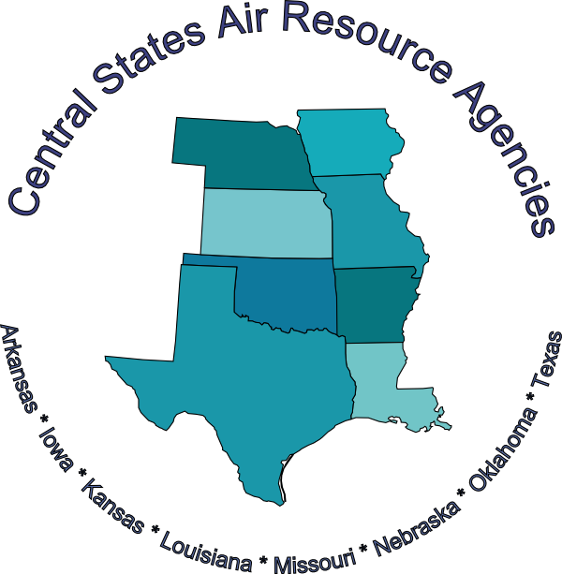
State Implementation Plan
101
vr 1a

Slide 2
Tell us about yourself!
Name
Organization
How long have you been in Air Quality and/or working on SIPs?

Slide 3
Goals of the Class
Understanding of what a State Implementation Plan is
Your role
The steps and various information that goes in a plan – the who, what, when, where and why!

Slide 4
Agenda
Welcome, Logistics and Introductions
Details we won’t cover
Clean Air Act/National Ambient Air Quality Standards (NAAQS) - detail
Area designation processes – detail
What we will cover
Overview of SIPs
Types of SIPs
SIP components
State and EPA staff and roles and responsibilities
Technical data needed
SIP Preparation and Submittal
What happens after a SIP is submitted to EPA
Resources
Debrief

Slide 5
Overview
Overview

Slide 6
What is a State Implementation Plan
Overview
State Implementation Plans from Terms of Environment
EPA approved state plans for the establishment, regulation, and enforcement of air pollution standards.
Purpose
A plan that is designed by a state to implement and meet federal Clean Air Act requirements.
Commitments
The plan documents the State/Local/Tribal commitments to implement programs and controls.
Legally Binding
The commitments and controls committed to within the plan must be enforceable.
Where can you find federally approved plans?
(demo) https://www.epa.gov/air-quality-implementation-plans/approved-air-quality-implementation-plans

Slide 7
Interesting Tidbits
Overview
Original SIPs were approved by EPA
all 50 states, 4 U.S. Territories, and Washington D.C.
May 31, 1972 (37 FR 10842) –also known as the “mother” SIPs.
Technically, all SIPs after 1972 are SIP revisions.

Slide 8
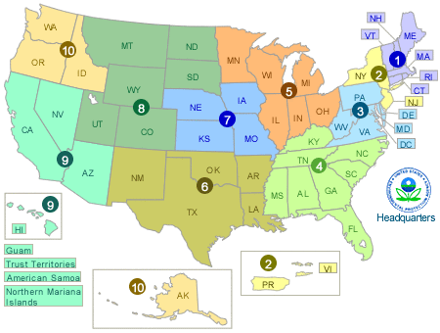
SIP starting points
Overview
Current Reference(s):
CFR 40, Parts 51 and 52
CAA Title I, Part A, Sec. 110 (Implementation plans)
CAA Title I, Part D, Sec. 171-192(Plan Requirements for Nonattainment Areas)
https://www.epa.gov/clean-air-act-overview/clean-air-act-text
https://www.epa.gov/environmental-topics/air-topics
https://www.epa.gov/air-research
https://www.epa.gov/air-quality-implementation-plans

Slide 9
Triggers for SIPs or SIP amendments
Overview
Depends on type of SIP (different types to be discussed later)
New or revised NAAQS/call for designations
New or revised federal requirements/programs
Local programs/areas - update emissions, update models
Commitments in current SIP

Slide 10
Reminder about Designation Definitions
Overview
Attainment
Area that meets the NAAQS
Nonattainment
Area that does not meet primary and secondary NAAQS for a specific pollutant
Unclassifiable
Area with insufficient data to determine the status for that area

Slide 11
Just a reminder – Nonattainment Classifications
Overview
Ozone
Marginal
Moderate
Serious
Severe
Extreme
Carbon Monoxide (CO) and PM2.5
Moderate
Serious
PM10
All nonattainment areas originally Moderate
If missed attainment deadline, reclassified as Serious
Other NAAQS (Lead, SO2)
Nonattainment

Slide 12
How designations are done for new nonattainment areas - simplified
Overview
Monitoring Data
All monitoring data is uploaded to EPA: https://www.epa.gov/aqs
Exceptional Events are important to document - data waived for classification purposes if EPA approves exceptional event determination
Area Boundaries
States make recommendations on classifications throughout the state including potential nonattainment boundaries - EPA determines final classifications and boundaries for nonattainment areas
EPA often relies on jurisdictional boundaries for nonattainment - counties very large in western states
Data will be needed if smaller size area is warranted/needed - takes time to gather

Slide 13
Timelines/Clocks
Overview
Clean Air Act sets timelines by pollutant
Can have overlapping timelines if more than one pollutant involved
Changing standards increases complexity

Slide 14
Due Date Timeframes – Infrastructure SIP
Overview
Program | Infrastructure SIP Due | Due Date to EPA | Attainment
Criteria Pollutant | Promulgation of NAAQS + 3 years | Designation date + 18 - 48 months | Designation date + up to 5 (or more) years
Regional Haze | n/a | 2008, 2021 and 2028 and every 10 years after (reasonable progress demos) | 2064 (natural conditions)
Exceptional Events Plan | n/a | Prior to attainment deadline | n/a
Ozone (and PM2.5) Advance Plan | n/a | Prior to nonattainment designation | n/a

Slide 15
Best chance for success – Time Management: keeping track, managing, and communicating
Overview
Understanding both state and federal timelines and processes
Tools for calculating (demonstration - example tool)
What can you do with the time you have available
Key: Communicating your timeframes (within and without)

Slide 16
Consequences of not doing a SIP or EPA not approving a SIP
Overview
Clean Air Act and EPA rules have specific consequences for failure to meet its requirements, depending on the type of SIP
Consequences usually 'kick in' upon failure to comply with an EPA action
Ex: 2 to 1 emission offsets; 18 months after EPA issues failure to submit
Ex: Federal Highway Fund sanctions; 6 months after date of offset sanctions
Ex: Federal Implementation Plan (FIP); 2 years after EPA determines a failure to submit or disapproves a SIP
More on FIPs in SIP Submittal Section

Slide 17
Misc. or on-going issues with SIPs in general
Overview
Exceptional events demonstrations can waive data from designation/attainment (can’t meet attainment)
https://www.epa.gov/air-quality-analysis/final-2016-exceptional-events-rule-supporting-guidance-documents-updated-faqs
Exceptional Event Demonstration and Mitigation Plan
Currently applicable to Ozone and PM.
Provides that states can demonstrate that monitoring values that contributed to a violation of the NAAQS could not have been avoided.
Result from unusual or naturally occurring events that cannot be reasonably controlled.
Ex: fireworks, volcanic eruptions, wildfires, natural dust
If EPA concurs with the state’s argument/demonstration, the monitoring values are removed from the calculation to determine attainment.

Slide 18
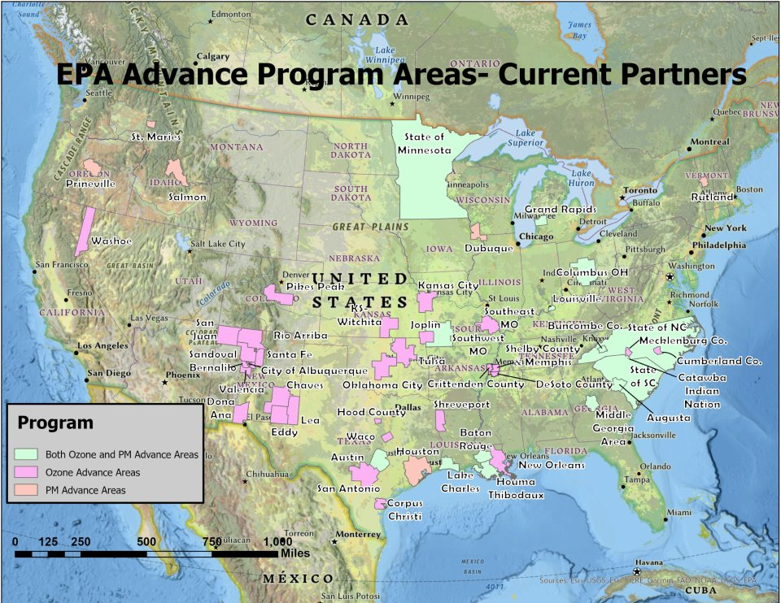
Relief from Nonattainment SIPs
Overview
Advance Program
Applies in Ozone and PM2.5 Attainment Areas
Provides a tool for working with communities to put into place actions/programs that can help avoid a nonattainment designation
www.epa.gov/advance

Slide 19
Relief from Nonattainment SIPs
Overview
Clean Data Finding
When a nonattainment area monitors attainment prior to the SIP submittal deadline or the CAA deadline.
Three years of violation-free monitored data required.
Finding may be initiated via state request or EPA initiation.
Relieves the state from some SIP requirements, such as Reasonable Further Progress (RFP) and Attainment Demonstration.
Area retains a nonattainment designation status.
https://www.epa.gov/ground-level-ozone-pollution/redesignation-and-clean-data-policy-cdp

Slide 20
SIP Types & Their Basic Requirements
Overview
Infrastructure (I-SIP)
Attainment
Maintenance
Transport/Good Neighbor
Conformity
Control Measure
Regional Haze
Tribal Implementation Plan (TIP)

Slide 21
Infrastructure SIP (I-SIP); CAA 110(a)(2)
Overview-Type of SIP
Required from all States and U.S. Territories within three years after promulgation of a new or revised NAAQS.
DC Circuit Court decision means a NAAQS is promulgated on the date it was signed by the EPA Administrator and made publicly available.
Other SIP-related effective dates are tied to Federal Register actions.

Slide 22
Basic I-SIP requirements
Overview-Type of SIP
What air quality monitoring program is in place for the NAAQS?
What authority and resources the state has for jurisdiction over air quality.
Information about the state’s technical programs, such as data collection/analyses/modeling systems.
What authority the state has for developing, implementing, and enforcing control measures.
I-SIP does not address what control measures will be needed to attain the NAAQS.
What public review process(es) the state uses.

Slide 23
Attainment Demonstration SIP
Overview-Type of SIP
A
T
T
A
I
N
M
E
N
T
S
I
P
A collection of documents that demonstrate what the state plans to do that will result in an area attaining the NAAQS. Plans are due to EPA 18+ months after the effective date of the NAAQS designation, depending on the severity of designation.
Plan includes:
Monitoring data
Emissions inventories
Modeling
Control strategies (could include RACT, RACM, BACT, BACM, PSD, NSR)
Compliance & enforcement
Administrative requirements, such as public notice and comment

Slide 24
Rate of Progress (ROP) SIP (Ozone only)
Overview-Type of SIP
A
T
T
A
I
N
M
E
N
T
S
I
P
1990 Clean Air Act Amendments required for moderate and above Ozone nonattainment areas.
15% ROP Plan
Due to EPA in 1996 to reduce VOC emissions by at least 15% from a 1990 baseline.
Post-1996 ROP Plan
Reduce VOC emissions by a minimum of a 3% average per year, across 3-year running averages beginning November 1996 until the ozone attainment date is reached.
NOx emission reductions can be substituted for VOC reductions.
Emission reductions from some motor vehicles control programs are excluded from the ROP plan.

Slide 25
Reasonable Further Progress (RFP) SIP
Overview-Type of SIP
A
T
T
A
I
N
M
E
N
T
S
I
P
Ozone moderate or higher designated areas
If attainment date is <= 5 years from designation, RFP is met by attainment demonstration SIP emissions reductions and no additional SIP is required.
If attainment date is > 5 years from designation, the RFP SIP provides 15% NOx or VOC emissions reductions within 6 years of designation; proportional reductions between the end of the first increment and attainment.
PM requires quantitative milestones be identified that will be achieved every 3 years until attainment.

Slide 26
Ozone Rural Transport Areas (CAA 182h)
Overview-Type of SIP
A
T
T
A
I
N
M
E
N
T
S
I
P
New (old) option with 2015 Ozone NAAQS.
Four areas were classified for 1979 1-hour ozone NAAQS.
Applicable for areas designated nonattainment that are not part of or adjacent to a metropolitan statistical area (MSA).
State must complete a marginal area attainment demonstration SIP to show that local NOx and VOC sources don’t contribute significantly to high ozone in the rural transport area or other areas.
If EPA approves, area can be redesignated to attainment.

Slide 27
Wrap-up: Attainment SIPs
Overview-Type of SIP
A
T
T
A
I
N
M
E
N
T
S
I
P
Avoid if at all possible
SIPs are expensive, especially nonattainment SIPs
Once a nonattainment area, some control measures and requirements NEVER go away, even when area reaches attainment
Nonattainment to full Attainment takes 20 + years
Try to be proactive to prevent nonattainment

Slide 28
Maintenance SIP (CAA 175A)
Overview-Type of SIP
Applies to any NAAQS.
Reinforces that area will remain in attainment for at least 20 years after redesignation to attainment.
1st SIP covers 10 years.
2nd SIP covers additional 10 years after the end of the first maintenance period.

Slide 29
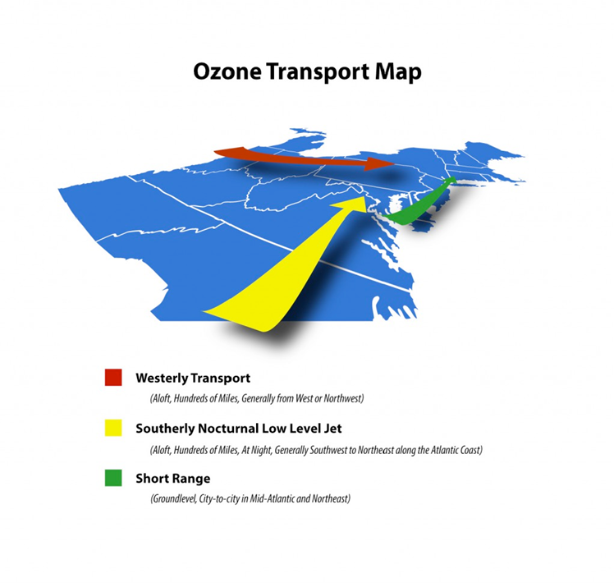
Transport/Good Neighbor SIP
Overview-Type of SIP
Reference(s):
CAA, Title I, Part A, 110(a)(2)(D)(i)(l)
CAA, Title I, Part D, 176A
States must show their emissions do not contribute significantly to “downstream” areas or if they do, what measures will be put in place to reduce the applicable emissions.
The CAA 176A allows for transport regions to be created – the Ozone Transport Commission was formed to address northeast U.S. issues.

Slide 30
International Transport – (CAA 179b)
Overview-Type of SIP
For areas that would attain an Ozone, CO or PM10 NAAQS but for emissions emanating from outside the U.S.
State must prepare and submit a SIP with relevant technical work and control measures developed for the area.
Nonattainment designation remains, but attainment deadline doesn’t apply.

Slide 31
Conformity SIPs
Overview-Type of SIP
Activities funded by or approved by federal agencies must conform to a state’s attainment or maintenance area SIP.
“Conform” is defined as: activities that will not cause or contribute to new air quality violations, worsen existing violations, or delay attainment of air quality standards.

Slide 32
Transportation Conformity
Overview-Type of SIP
Transportation Conformity requires SIP commitments and infrastructure regulations that layout interagency consultations, how disputes are resolved and provides specific definitions for air agencies and transportation agencies to follow.
Applies only to nonattainment or maintenance areas; and
"Regionally Significant" transportation projects located outside of nonattainment or maintenance areas that could potentially impact the nonattainment or maintenance area.
Primarily FHWA funding or FHWA/DOT actions
More details later.
https://www.epa.gov/state-and-local-transportation/general-information-transportation-and-conformity
https://www.epa.gov/state-and-local-transportation/transportation-conformity

Slide 33
General Conformity (SIP requirements revised in 2010)
Overview-Type of SIP
Applies to nonattainment and maintenance areas.
Federal Agencies typically involved: HUD, FAA, Corp of Engineers, etc.
Three exceptions:
Actions covered by the transportation conformity rule.
Actions with associated emissions below specified de minimis levels. BEWARE - consultation with local air agencies are only required for projects that exceed de minimis and require a general conformity determination. Federal agency often makes de minimis determination. BE INVOLVED –Ask for documentation of how de minimis was determined.
Other actions that are either exempt or presumed to conform.

Slide 34
General Conformity, cont.
Overview-Type of SIP
In an area with an approved SIP, conformity can be demonstrated by one of the following:
Showing that the emission increases caused by an action are included in the SIP.
Demonstrating that the state agrees to include the emission increases in the SIP.
Offsetting the action’s emissions in the same or nearby areas.
Taking mitigation actions to reduce the emission increase.
Air quality modeling demonstration.

Slide 35
General Conformity, cont.
Overview-Type of SIP
In an area without an approved SIP, a federal action can be shown to “conform” by demonstrating there will be no increase in emissions in the NAA or maintenance area from the federal agency action that could cause new violations of the NAAQS and/or no increase in the frequency or severity of previous violations.
https://www.epa.gov/general-conformity

Slide 36
Control Measure SIP
Overview-Type of SIP
Some control strategies are complex enough to warrant their own SIP Revision
Ex: Vehicle Inspection and Maintenance
Ex: Prevention of Significant Deterioration/New Source Review
Ex: Minor Source Permit Program
Ex: Clean Fuel Program

Slide 37
Control Measure SIP, cont.
Overview-Type of SIP
Vehicle Inspection and Maintenance
Required in Ozone moderate and above areas (CAA 182(b) and (c)), CO moderate and serious areas (CAA 187)
For serious areas, state must submit biennial report to EPA administrator summarizing emission reductions
Clean Fuel Programs required in Ozone and CO serious and above areas
More in Technical Data Needed Section about PSD, NSR and Title V

Slide 38
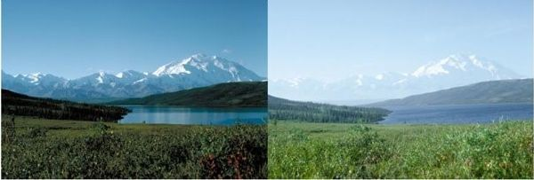
Regional Haze SIP – CAA 169A
Overview-Type of SIP
All states are required to show progress toward natural visibility conditions in Class I areas by 2064.
Class I areas are national parks, wilderness areas, national forests and monuments.
Reasonable Progress: SIPs required every 10 years; interim progress report every 5 years.
Round 1 SIP included consideration of retrofit controls on existing large stationary sources: BART (Best Available Retrofit Technology).
Natural and Hazy Conditions
Image credit: Denali NPP, ©Alaska Division of Tourism

Slide 39

Tribal Implementation Plan (TIP)
Overview-Type of SIP
Tribes have similar authority as states in the CAA.
Although not a requirement, Tribes can be the authority for the air quality program within their own boundaries.
The Tribal Authority Rule (TAR) provides regulatory framework for developing TIPs.
Like SIPs, TIPs must demonstrate that Tribes have the necessary resources and authority.
Photo: EPA https://www.epa.gov/tribal-air

Slide 40
Roles and Requirements
Roles & Requirements

Slide 41

How to put together a SIP
Roles & Requirements
I don’t know where to start!
So many burning questions:
What is required?
Where do I find detailed information and data?
Who is involved?
How do I bring it together?
What can I expect?

Slide 42

Understand the Requirements
Roles & Requirements
Federal Requirements
Clean Air Act
Federal Register
Guidance Documents
EPA Tools
Specific State Issues
Statutes or rules that may impact development
Important to start work early with the regional EPA staff and EPA checklists
What is new on this type of SIP from EPA?
What are they looking for and expecting to see in this SIP?
More on this later in the course....

Slide 43


Roles
Roles & Requirements
Identify who needs to be involved and who will be impacted by this SIP
There are many people, organizations, and roles that play a part within the SIP development, review/approval, and implementation process
Figure out who is or should be "playing in the sandbox" with you!
Internal technical staff
Internal policy and decision makers
Staff from other governmental organizations
Elected officials
External Stakeholders

Slide 44
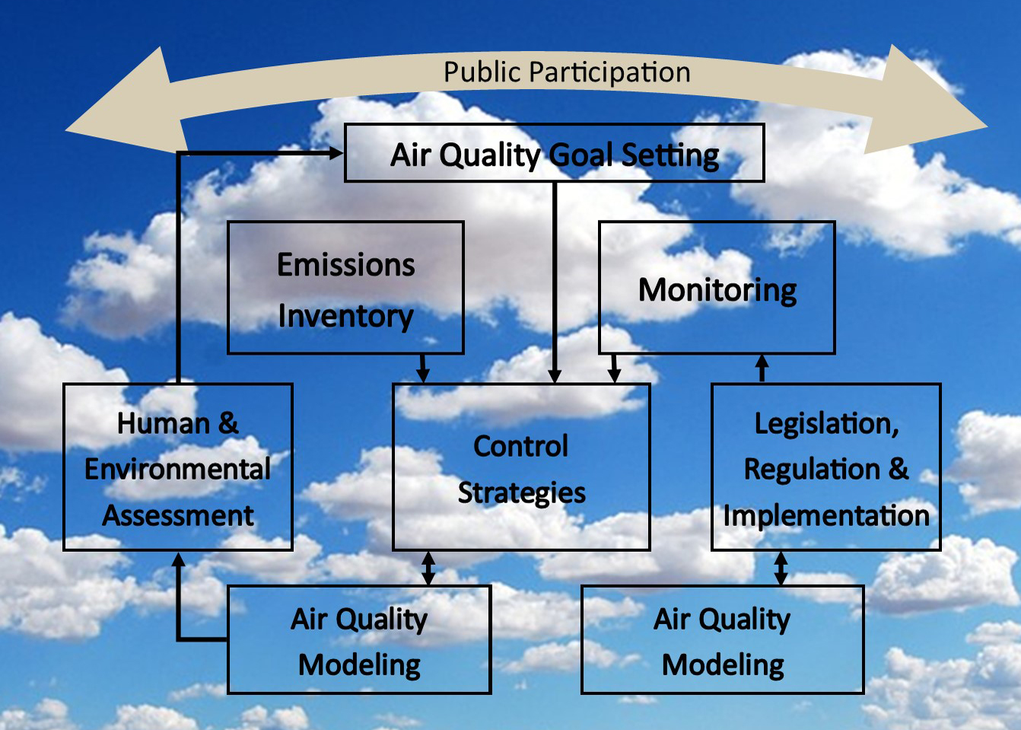
SIP Roles in Air Quality Management
Roles & Requirements

Slide 45
External Stakeholders
Roles & Requirements
Public
Anyone, anyplace.
Procedures must be in place to provide the public an opportunity to review a SIP before submission to EPA.
Public notice, public hearing and 30-day comment period.
Stakeholders (often involved during the development phase)
Those who may have vested interest in the outcome – i.e., potentially regulated sources, local communities, other states (especially those contributing emissions to the nonattainment area).
Environmental/public interest organizations.
National, regional or local organizations (ex: Ozone Transport Commission).

Slide 46
State/Tribe
Roles & Requirements
Where the rubber meets the road – overall responsibility for the air quality program development, implementation and enforcement.
Needs to understand the source/fate/transport/background of air pollution within the agency’s jurisdiction in the context of Federal air pollution laws and regulations.
Responsible for source category inventories, modeling and control measure development, within the agency’s jurisdiction.
Issues and enforces permits.
Is the center of communication for stakeholder processes.

Slide 47
Local Units
Roles & Requirements
In some areas, local units have jurisdiction to develop and implement SIPs
Ex: California air quality districts
Ex: Maricopa County, Arizona (by law)
Ex: Memorandums of Understanding between State and Local Unit
In some areas, local units may need to develop control strategies
In some areas, organizations within local units may need to be involved
Ex: Metroplitan Planning Organizations (MPOs) regarding emission budgets/transportation measures

Slide 48
EPA
Roles & Requirements
May provide assistance throughout the SIP development process through rules, guidance documents memos, attending meetings.
Participation can increase a SIP’s chance of ultimate approval.
Must review and take action on submitted SIPs (CAA (110(k)).
Within 6 months of SIP submittal, EPA must take action or SIP is deemed complete (but not approved).
Official actions are documented in the Federal Register (FR) and codified in the Code of Federal Regulations (CFR).
Responsible for developing a Federal Implementation Plan (FIP) if SIP not timely submitted or disapproval not addressed by state.

Slide 49
Important Roles for Two Unique SIPs
Roles & Requirements
Transportation Conformity
Metropolitan Planning Organization (MPO) for communities with a population of over 50,000 as determined by the U.S. Census.
Department of Transportation
Work to increase their knowledge regarding the tie-in between Air Quality and Transportation
There could be opportunities for funding assistance
Regional Haze
Federal Land Managers
Tribes
Small communities

Slide 50
Transportation Conformity Roles and Responsibilities
Roles & Requirements
US DOT (FHWA/FTA) | Approves conformity determinations on transportation plans, transportation improvement plans (TIPs), and projects
Metropolitan Planning Organizations (MPOs) | Prepares the conformity determination for transportation plans and Transportation Improvement Plans (TIPs)
State Dept. of Transportation and Transit Agencies | Prepares project-level conformity determination
State and Local Air Agencies | Develops the motor vehicle emissions budget (MVEB); consults on conformity determinations
EPA | Consults on the conformity process; conformity regulations and guidance

Slide 51
Regional Haze SIP Roles
Roles & Requirements
Same as previous SIPs discussed
Public
Stakeholders (Sources, etc.)
States and Tribes
Locals
EPA
+
Regional Planning Organizations
May help with technical work, data analysis, monitoring
Federal Land Managers
As managers of Class I Areas, interested in seeing progress in visibility
Notes:
Western States - WRAP
SE States - VISTAS

Slide 52
Environmental Justice Communities/Populations
Roles & Requirements
Environmental justice (EJ) is the fair treatment and meaningful involvement of all people regardless of race, color, national origin, or income with respect to the development, implementation and enforcement of environmental laws, regulations and policies.
Fair treatment means no group of people should bear a disproportionate share of the negative environmental consequences resulting from industrial, governmental and commercial operations or policies.
Meaningful involvement means:
People have an opportunity to participate in decisions about activities that may affect their environment and/or health;
The public's contribution can influence the regulatory agency's decision;
Community concerns will be considered in the decision-making process; and
Decision makers will seek out and facilitate the involvement of those potentially affected.

Slide 53
Environmental Justice Communities/Populations
Roles & Requirements
EPA Resources
https://www.epa.gov/external-civil-rights
https://19january2021snapshot.epa.gov/ejscreen_.html (archived site)
State Specific Programs and Requirements (examples)
Arizona: https://www.azdeq.gov/MyCommunity
California: https://calepa.ca.gov/envjustice/
Colorado: https://cdphe.colorado.gov/environmental-justice
Hawaii: https://health.hawaii.gov/epo/ej/
Oregon: https://www.oregon.gov/deq/about-us/pages/environmental-justice.aspx
Maryland: https://mde.maryland.gov/Environmental_Justice/Pages/Landing%20Page.aspx
Minnesota: https://www.pca.state.mn.us/about-mpca/environmental-justice
New Mexico: https://www.env.nm.gov/general/environmental-justice-in-new-mexico/
New York State: https://www.dec.ny.gov/public/333.html
Utah: https://deq.utah.gov/general/environmental-justice-in-utah
Washington State: https://ecology.wa.gov/About-us/Who-we-are/Environmental-Justice
West Virginia: https://dep.wv.gov/environmental-advocate/Pages/default.aspx

Slide 54
Hands On Learning – Examples and Tools
Hands On Exercise/Tools
How to proactively analyze stakeholder interest and influence
Alaska case study – early public engagement
Developing communication plans for SIP projects

Slide 55
Identifying Stakeholders
Hands On Exercise/Tools
Key stakeholders must be at least minimally satisfied
Create and sustain coalitions of stakeholders
Stakeholder analysis helps us to figure out how to frame the key challenges
Stakeholders can be organized in terms of their presumed INTEREST in decision making to achieve better outcomes and their POWER to help to produce the outcomes
Example(s) of ways to analyze and organize (Activity)

Slide 56
Stakeholders Exercise
Discuss some SIPs you are working on
Select a SIP project (or work through a couple SIP projects)
Identify Stakeholders (5-10)
Internal
External
What are your Stakeholders Interests?
What do you need from your Stakeholders?
What power/influence does a Stakeholder have?

Slide 57
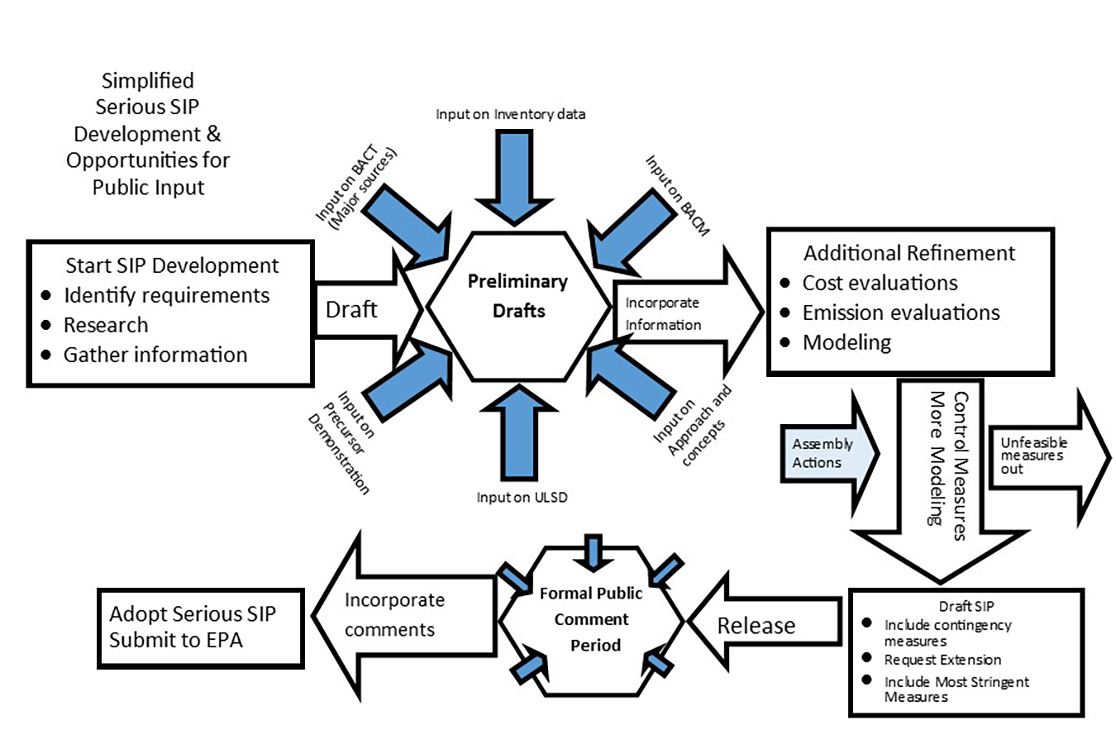
Alaska Case Study – A tool to generate interest
Hands On Exercise/Tools
Moderate SIP to Serious SIP effort
Released Preliminary Draft documents on initial data gathered
Spurred local Stakeholder effort
Gathered additional data as affected sectors checked the data presented
Approach did not require response to comments
Public opportunity to see full picture prior to formal public process
EPA given opportunity to see and comment on data informally
https://dec.alaska.gov/air/anpms/communities/fbks-pm2-5-sip-development/

Slide 58
Developing Communication Plans
Hands On Exercise/Tools
Identify audiences/stakeholders
What methods of outreach would be effective to reach audiences?
What messages do you need or want to convey?
When do you need to communicate?
How can you communicate the messages?
What resources do you have or need to implement the plan?

Slide 59
Technical Data Needed
Technical Data Needed

Slide 60
Identifying Technical Information Needs (depends on SIP type)
Technical Data Needed
SIP Technical/Regulatory Components
Ambient Air Quality Monitoring
Emissions Inventories & Modeling
Air Quality Modeling
Control Strategies & Permits
What Not to put in a SIP
Programs/regulations you do not want EPA to enforce

Slide 61
Precursor Pollutants
Fine Particulate Matter – direct PM2.5 and indirect PM2.5
Nitrogen oxides
Sulfur dioxide
Ammonia
Volatile Organic Compounds
Ozone
Nitrogen oxides
Volatile Organic Compounds
Carbon Monoxide

Slide 62
What is AQ monitoring data used for and why
Technical Data Needed
AQ
M
O
N
I
T
O
R
I
N
G
National Air Quality Standards (NAAQS)
Design Values and Progress Trends
Public Health Announcements
Validating Models and Effectiveness of Control Strategies
Precursor Demonstrations
Research
Citizen Science

Slide 63
What is AQ monitoring data and how to find it
Technical Data Needed
AQ
M
O
N
I
T
O
R
I
N
G
CAA Section 319
Requires an air quality monitoring system throughout the U.S. to meet multiple objectives and provide recordkeeping with respect to such monitoring data
Supports periodic analysis and reporting to the general public by the Administrator with respect to air quality trends
https://www.epa.gov/outdoor-air-quality-data
https://www.airnow.gov/
https://www.epa.gov/aqs

Slide 64
40 CFR Parts 53 and 58
Technical Data Needed
AQ
M
O
N
I
T
O
R
I
N
G
The “Home” of requirements for:
Method approvals
Sampling frequency
Network design
Annual plans and Network assessments
Monitoring location
Quality Assurance
Data reporting

Slide 65
Ambient Air Quality Monitoring
Technical Data Needed
AQ
M
O
N
I
T
O
R
I
N
G
Objectives of the National Air Quality Monitoring Network:
Supports compliance with the NAAQS
Provides timely air quality data to the public
Supports air pollution research studies
Validates emissions models and verifying control strategy effectiveness
Network Operators: Federal and State, Tribe and/or Local agencies

Slide 66
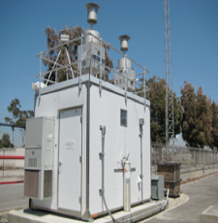
Ambient Air Quality Monitoring, cont.
Technical Data Needed
AQ
M
O
N
I
T
O
R
I
N
G
Reference(s):
AirKnowledge Ambient Air Monitoring (AMBM) e-learning: https://airknowledge.gov/AMBM-SI.html
EPA Managing Air Quality - Ambient Air Monitoring: https://www.epa.gov/air-quality-management-process/managing-air-quality-ambient-air-monitoring
Ambient Air Monitoring Technical Information Center: https://www.epa.gov/amtic
Monitoring Shed

Slide 67




Definitions
Technical Data Needed
AQ
M
O
N
I
T
O
R
I
N
G
Monitor: A device used to measure air quality, typically automated continuous gases such as Ozone (O3) and Carbon Monoxide (CO).
Sampler: A device that supports manually operated, filter-based methods, typically for particles and/or air toxics measurements
Station: a physical monitoring location (with a building or platform) that houses monitors and samplers
Network: A collection of monitoring stations of a given type or types.

Slide 68
SLAMS Network State and Local Air Monitoring Stations (SLAMS)
Technical Data Needed
AQ
M
O
N
I
T
O
R
I
N
G
Ozone, CO, SO2, NOx
Air Toxics
NCore (National core monitoring sites – multi-pollutant high spatial and temporal resolution monitors)
PM10 and PM2.5
Chemical Speciation
Lead Monitoring
Meteorological Measurements
Near-road CO, NO2, and PM2.5 Monitoring
Susceptible and Vulnerable Populations - NO2 Monitoring

Slide 69
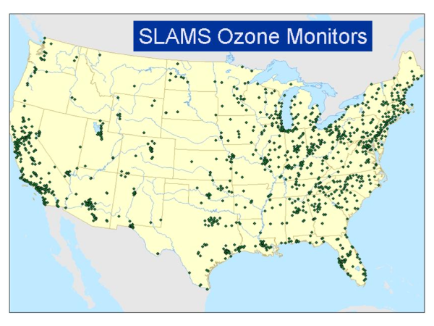
Technical Data Needed
AQ
M
O
N
I
T
O
R
I
N
G

Slide 70
Surface Air Quality Data
Technical Data Needed
AQ
M
O
N
I
T
O
R
I
N
G
EPA Air Quality System (AQS) is the repository for SLAMS and other network data
Surface Air Quality Data has historically covered urban areas
Stations in rural areas becoming more frequent

Slide 71
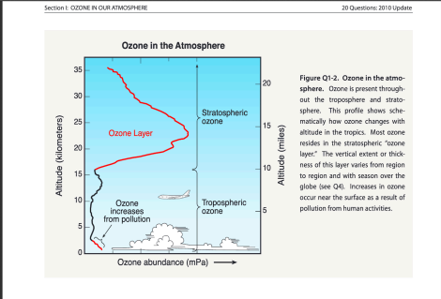
Surface Air and Ozone
Technical Data Needed
AQ
M
O
N
I
T
O
R
I
N
G

Slide 72
EPA AQS Surface Air Quality Data
Technical Data Needed
AQ
M
O
N
I
T
O
R
I
N
G
Data included in the AQS
Hourly O3, NO2, NOx, CO, PM10, and PM2.5
Federal Reference Method (FRM) measures 24-hour total PM2.5 mass every 1-3 days
Chemical Speciation Network (CSN) measures 24-hour average speciated PM2.5, including SO4, NO3, NH4, EC, OC, and elements every 1-6 days

Slide 73
AirNow Data
Technical Data Needed
AQ
M
O
N
I
T
O
R
I
N
G
For ozone and PM2.5
Provides ability to compare recent air quality data not yet available from AQS with historic levels.
AQI data are not fully verified and validated through the quality assurance procedures and, therefore, cannot be used to formulate or support regulation, guidance or any other Agency decision or position.
https://www.epa.gov/outdoor-air-quality-data
AQS data, as it becomes available, replaces any AirNow data.

Slide 74
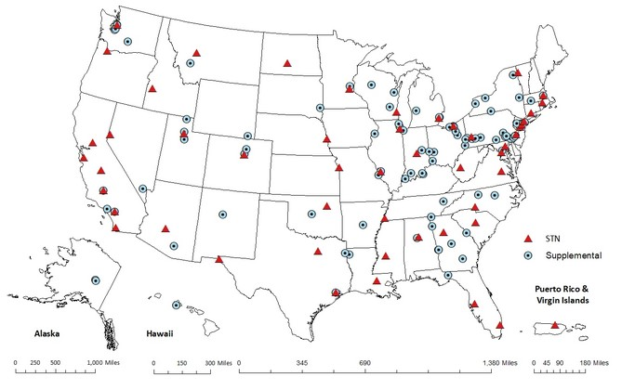
CSN - Chemical Speciation Network
Technical Data Needed
AQ
M
O
N
I
T
O
R
I
N
G
PM_{2.5} Chemical Speciation Network (CSN) consisting of Speciation Trends Network (STN) sites and supplemental speciation sites
Established in late 1990s.
Teflon filters are analyzed for 33 elements, nylon filters are analyzed for ions and quartz filters are analyzed for carbon.
https://www.epa.gov/amtic/chemical-speciation-network-csn

Slide 75
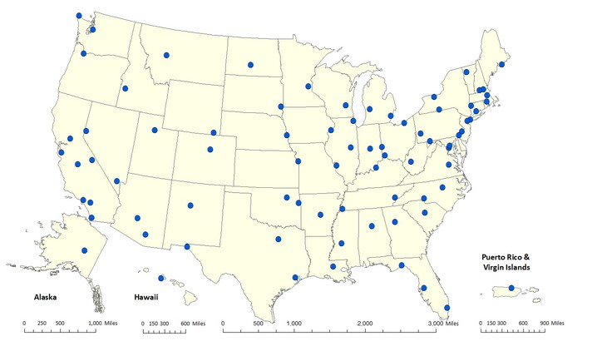
NCore - National Core Monitoring Network
Technical Data Needed
AQ
M
O
N
I
T
O
R
I
N
G
Multi pollutant network that integrates several advanced measurement systems for particles, pollutant gases and meteorology.
Network started January 1, 2011.
Measures: PM2.5 speciation, PM2.5 FRM mass, continuous PM2.5 mass, PM10-2.5 mass, O3, CO, SO2, NO, total reactive nitrogen (NOy), surface meteorology.
The requirements for NCore monitoring can be found in 40 CFR part 58 Appendix D
https://www.epa.gov/amtic/ncore-monitoring-network

Slide 76
Non-AQS Aerometric Monitoring Networks Interagency Monitoring of Protected Visual Environments (IMPROVE)
Technical Data Needed
AQ
M
O
N
I
T
O
R
I
N
G
Primarily located in rural Class I areas at National Parks, Wilderness Areas, and Fish & Wildlife Refuges – critical for Regional Haze SIPs
Measures 24-hour average PM2.5, PM10 mass, and speciated PM2.5, including SO4, NO3, EC, and OC every 1-3 days
http://vista.cira.colostate.edu/Improve/

Slide 77
Non-AQS Aerometric Monitoring Networks Clean Air Status and Trends Network (CASTNet)
Technical Data Needed
AQ
M
O
N
I
T
O
R
I
N
G
Established to assess trends in pollutant concentrations, atmospheric deposition, and ecological effects due to changes in air pollutant emissions. Sites are mainly in rural areas
Measures hourly O3, temperature, wind speed/direction, potential temperature, solar radiation, relative humidity, precipitation, and surface wetness
Measures weekly samples of SO2, HNO3, and speciated PM2.5, including SO4, NO3, NH4
https://www.epa.gov/castnet

Slide 78
Non-AQS Aerometric Monitoring Networks National Acid Deposition Program (NADP)
Technical Data Needed
AQ
M
O
N
I
T
O
R
I
N
G
Sites in mainly rural areas away from large point sources
Measures weekly samples of SO4, NO3, NH4 wet deposition and SO4 and NO3 dry deposition
Some sites include NH3 measurements
Some sites include Hg measurements
http://nadp.slh.wisc.edu/

Slide 79
Other Monitoring Data
Technical Data Needed
AQ
M
O
N
I
T
O
R
I
N
G
Research/Sensor Studies
Satellites
NASA’s Tropospheric Emission Monitoring of Pollution (TEMPO) mission: https://tempo.si.edu/
Citizen monitoring data
Purple Air and other common sites
https://map.purpleair.com

Slide 80
What are monitored data used for in the SIP?
Technical Data Needed
AQ
M
O
N
I
T
O
R
I
N
G
Design values are calculated from regulatory monitoring data based on the pollutant and form of the standard.
Developing design values for the NAAQS - four parts:
Indicator
e.g., ozone, PM2.5
Averaging period
e.g., 1 hour, 8-hours, 24-hours, annual
Statistical form
e.g., three-year average of 4th highest daily maximum 8-hour concentration
Level (the concentration)
Design values are compared to the NAAQS to determine attainment status

Slide 81
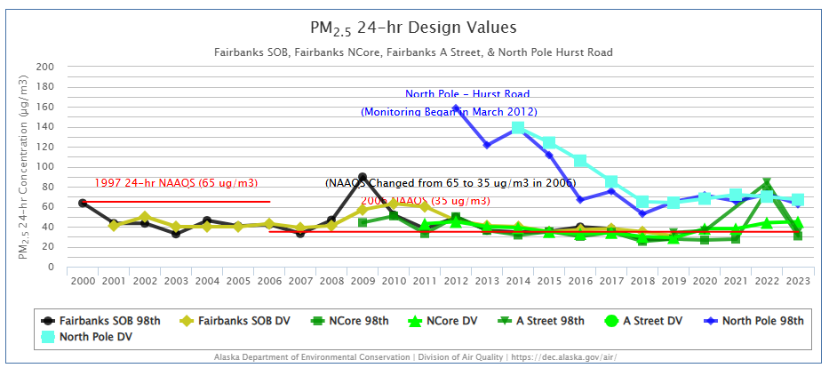
Example: PM2.5 Design Values – Fairbanks, AK
Technical Data Needed
AQ
M
O
N
I
T
O
R
I
N
G

Slide 82
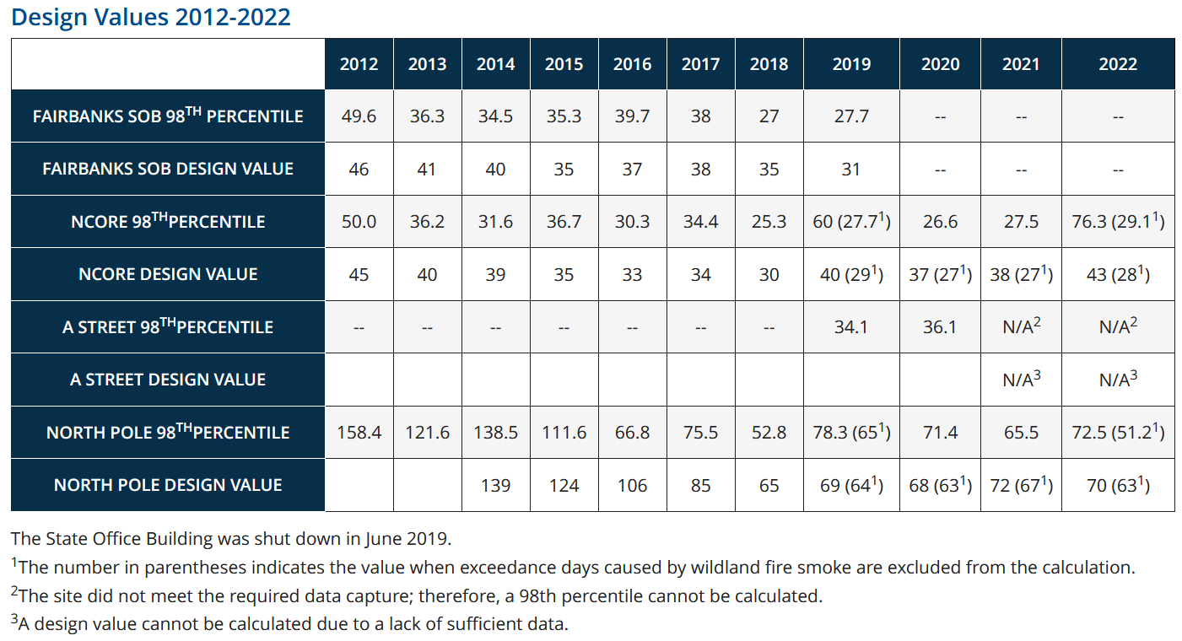
Example: PM2.5 Design Values – Fairbanks, AK
Technical Data Needed
AQ
M
O
N
I
T
O
R
I
N
G

Slide 83
Networking with Air Monitoring Staff
Technical Data Needed
AQ
M
O
N
I
T
O
R
I
N
G
Get to know your Air Monitoring Staff!
You will need them!
Usually overworked and understaffed, need a lot of advanced notice of what is needed if they haven't supported a SIP before.
Questions – discussions?

Slide 84

Emission Inventories & Modeling
Technical Data Needed
E
M
I
S
S
I
O
N
I
N
V
E
N
T
O
R
Y
Reference(s):
AirKnowledge e-learning: https://airknowledge.gov/EMIS-SI.html
Technical Work: https://www.epa.gov/air-emissions-inventories

Slide 85
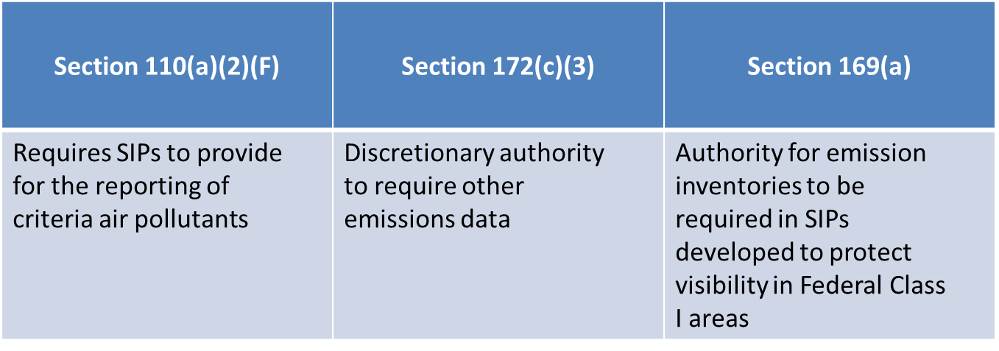
Clean Air Act Requirements for Emissions Inventories
Technical Data Needed
E
M
I
S
S
I
O
N
I
N
V
E
N
T
O
R
Y

Slide 86
Air Emissions Reporting Requirements (AERR)
Technical Data Needed
E
M
I
S
S
I
O
N
I
N
V
E
N
T
O
R
Y
EPA promulgated the AERR in December 2008.
The AERR consolidated and streamlined previous requirements of several older rules for states and local air pollution control agencies to submit emissions inventories for criteria pollutants to EPA's Emissions Inventory System (EIS)
Many of the states also voluntarily report air toxics that are also used in building the NEI
https://www.epa.gov/air-emissions-inventories/air-emissions-reporting-requirements-aerr

Slide 87
What is an Emissions Inventory?
Technical Data Needed
E
M
I
S
S
I
O
N
I
N
V
E
N
T
O
R
Y
Current comprehensive listing by sources of air pollutant emissions in a geographical area during a specific time period
The basis for numerous efforts including trends analysis, regional, and local scale air quality modeling, regulatory impact assessments, and human exposure modeling
Pollutants:
Criteria Air Pollutants (CO, NOx, SO2, NH3, VOC, PM2.5 and PM10)
Hazardous Air Pollutants (e.g., Benzene, Acetaldehyde)
Greenhouse Gases (e.g. CO2, CH4, N2O)

Slide 88
Sectors and Source types
Technical Data Needed
E
M
I
S
S
I
O
N
I
N
V
E
N
T
O
R
Y
Point sources
Area sources
Nonpoint sources
Onroad and
Nonroad Mobile sources
Event/Natural sources
Biogenic
Wildfire/Dust
Emergency Releases

Slide 89
Source Classification Codes (SCC)
Technical Data Needed
E
M
I
S
S
I
O
N
I
N
V
E
N
T
O
R
Y
SCCs are important to ensuring an accurate emission inventory
EPA uses SCCs and area and mobile source (AMS) codes to classify different types of anthropogenic emission activities.
SCCs are either 8 or 10 digits long. Most point source SCCs are 8 digits long, with exceptions to a handful of point SCCs, such as aircraft exhaust and airport ground support equipment, which are 10 digits long and included in the point inventory because they are developed at discrete locations. Nonpoint, mobile, and events codes are 10 digits long.
Emission pre-processors, like SMOKE, use the SCC in characterizing the emission source.
Look up SCC on EPA's website at: https://sor-scc-api.epa.gov/sccwebservices/sccsearch/

Slide 90
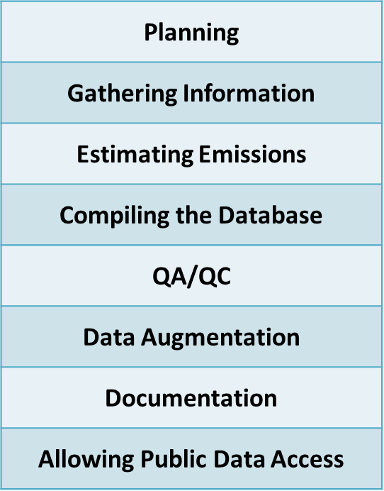
Emission Inventory Compilation Steps
Technical Data Needed
E
M
I
S
S
I
O
N
I
N
V
E
N
T
O
R
Y

Slide 91
Types of Air Pollution Emissions Inventories
Technical Data Needed
E
M
I
S
S
I
O
N
I
N
V
E
N
T
O
R
Y
National Emissions Inventory (NEI)
SIP Planning Inventory
Periodic NAA inventory
ROP/RFP NAA inventory
Maintenance NAA inventory
SIP Modeling Inventory
Modeled attainment demonstrations
EPA rule making
Global modeling

Slide 92
Types of Air Pollution Emissions Inventories, cont.
Technical Data Needed
E
M
I
S
S
I
O
N
I
N
V
E
N
T
O
R
Y
Projection/Future-year Inventory
Estimate of future emissions with growth and controls
Growth based on models (IPM, ERTAC), industry surveys, transportation plans, linear extrapolation, and other methods
Controls
On the books: currently promulgated rules and other enforceable mechanisms that will phase in through time
On the way: controls that are speculated to be promulgated
Brute-force projections may include across-the-board changes (i.e. 50% NOx reduction) to test the model and simulated air quality response

Slide 93
National Emissions Inventory (NEI)
Technical Data Needed
E
M
I
S
S
I
O
N
I
N
V
E
N
T
O
R
Y
The best and most complete estimates of Criteria Air Pollutant (CAP) and Hazardous Air Pollutant (HAP) emissions prepared by EPA
Must be done every three years
Based on S/L/T agency work that is submitted to EPA
Helps S/L/Ts meet CAA requirement that SIPs include emissions data and related information
Also helps S/L/Ts obtain emission data and information about other states to support modeled attainment demonstrations

Slide 94
Uses of the NEI
Technical Data Needed
E
M
I
S
S
I
O
N
I
N
V
E
N
T
O
R
Y
Regional- and local-scale air quality & human exposure modeling
Control strategy analysis
Regulatory impact analysis
Risk assessment studies
Emission trends and program accountability
Public reporting
International reporting

Slide 95
What is in the NEI?
Technical Data Needed
E
M
I
S
S
I
O
N
I
N
V
E
N
T
O
R
Y
Geographic Coverage
Entire U.S.
Individual process level inventory for point sources
County level inventory for non-point and mobile sources
Pollutants coverage:
Criteria Air Pollutants (CAPs)
CO, NOx, VOC, NH3, SO2, PM10, PM2.5
Ozone precursors: VOC, NOx ,CO
Direct PM emissions: PM10, PM2.5
PM precursors: VOC, NOx, SO2, NH3
Hazardous Air Pollutants

Slide 96
NEI Data Resources
Technical Data Needed
E
M
I
S
S
I
O
N
I
N
V
E
N
T
O
R
Y
S/L/T air agencies
EPA Data Systems
Emissions Inventory System (EIS)
Emissions Trading Program
Toxic Release Inventory (TRI)
EPA data collection programs
MACT compliance data
Information Collection Review (ICR) for NAAQS development
Clean Air Markets Division (CAMD) for large point sources
https://www.epa.gov/airmarkets
Data developed by EPA
Mobile Source models
EIAG data augmentation
Industry

Slide 97
Use of NEI by EPA
Technical Data Needed
E
M
I
S
S
I
O
N
I
N
V
E
N
T
O
R
Y
Emissions Modeling Platforms (EMPs)
EPA OAQPS develops EMPs with the best available inventories to support rulemaking
Combination of all available inventories
Purpose: Support Federal NAAQS revisions, SIP calls, and rulemakings
Base and future year emissions
Includes ancillary emissions data, modeling tools, and technical support documentation

Slide 98
Use of NEI by S/L/T
Technical Data Needed
E
M
I
S
S
I
O
N
I
N
V
E
N
T
O
R
Y
Required by CAA sections 172(c)(3) and 182(a)(1) for Attainment Demonstration and Rate of Progress/Reasonable Further Progress SIPs
Assessment of adequacy of Maintenance Plan 10-year life cycle
Development of control strategies, modeling
Develop base year and future year emissions
Covers Criteria Air Pollutants (CAPs)

Slide 99
Use of NEI by Regional Planning Organizations (RPOs)/ Multijurisdictional Organizations (MJOs)
Technical Data Needed
E
M
I
S
S
I
O
N
I
N
V
E
N
T
O
R
Y
Develop multi-state inventories for the Regional Haze Program
In some regions, RPOs also develop for PM and Ozone SIP control strategy modeling
Assists with Inter-RPO cooperation and data sharing

Slide 100
Modeling Inventory
Technical Data Needed
E
M
I
S
S
I
O
N
I
N
V
E
N
T
O
R
Y
Modeling inventories have specific requirements
Geographically resolved emissions (gridded or specific dimensions) - spatial allocation of emissions
Hourly time resolution - temporal allocation of emissions
Pollutant species (“model species”) to meet needs of AQ model chemical/physical algorithms
Quality Assurance/Quality Control of data
All sources (area/mobile/point/biogenic) represented
Can be a combination of several inventory sources (NEI, Periodic inventory, RPO Inventory)
Used for both SIP and non-SIP emissions modeling

Slide 101
RPO Inventory
Technical Data Needed
E
M
I
S
S
I
O
N
I
N
V
E
N
T
O
R
Y
Regional Planning Organizations (RPOs) may work with states in their region as well as across RPOs to leverage resources and ensure consistent emission estimates for use in regional haze and other planning efforts.
Important to be able to understand how adjoining states are estimating emissions to avoid anomalies from different approaches when modeling regional emissions.
Example:
VISTAS https://www.metro4-sesarm.org/content/vistas-regional-haze-program
WRAP EIs and Database at https://westar.org/
CENSARA Regional Haze Committee: https://www.censara.org/
MARAMA: https://marama.org/ and MANEVU: https://otcair.org/manevu

Slide 102
EPA Inventory Guidance
Technical Data Needed
E
M
I
S
S
I
O
N
I
N
V
E
N
T
O
R
Y
Emissions Inventory Guidance for Implementation of Ozone and Particulate Matter National Ambient Air Quality Standards (NAAQS) and Regional Haze Regulations
US EPA, May 2017
https://www.epa.gov/air-emissions-inventories/air-emissions-inventory-guidance-documents

Slide 103
Emission Inventory Development
Technical Data Needed
E
M
I
S
S
I
O
N
I
N
V
E
N
T
O
R
Y
Data from source-specific emission tests (source tests) or continuous emission monitors are usually preferred for estimating a source’s emissions because those data provide the best representation of the tested source’s emissions.
Emissions Factors (EFs) are a representative value that attempts to relate the quantity of a pollutant released to the atmosphere with an activity associated with the release of that pollutant.
E= (A x EF) x (1-ER/100)
E = Emissions (e.g. tons/year) is equal to the A = Activity (e.g. # hours, miles, etc. /year) multiplied by the EF and ER = emission reduction efficiency

Slide 104
AP-42 Compilation of Air Pollutant Emissions Factors
Technical Data Needed
E
M
I
S
S
I
O
N
I
N
V
E
N
T
O
R
Y
Published since 1972 as the primary compilation of EPA’s emission factors
Emissions factor and process information for >200 air pollution source categories
Compiled from source test data, material balance studies, and engineering estimates
Fifth Edition published in January 1995, updated with supplements and updates
https://www.epa.gov/air-emissions-factors-and-quantification/ap-42-compilation-air-emissions-factors

Slide 105
Webfire Compilation of Air Pollutant Emissions Factors
Technical Data Needed
E
M
I
S
S
I
O
N
I
N
V
E
N
T
O
R
Y
Online database of emissions factors for CAPs and HAPs
Industrial and non-industrial processes
Includes descriptive information on industry and source types, control device information, pollutants emitted, and supporting documentation
https://cfpub.epa.gov/webfire/

Slide 106
Collecting Activity Data
Technical Data Needed
E
M
I
S
S
I
O
N
I
N
V
E
N
T
O
R
Y
What data sources already exist?
Census
EPA
Other
What data sources are needed for your effort?
Surveys
Travel logs
Observation
Actuals from Specific Sources, where available
Timely request for information (at beginning)
Develop forms for data response (make it easier for them - and for you to post process)

Slide 107
Emissions Inventory System (EIS)
Technical Data Needed
E
M
I
S
S
I
O
N
I
N
V
E
N
T
O
R
Y
Provides access to emissions inventory data
Use by everyone during EI development results in more accurate and comprehensive NEI
Reduces the time it takes to develop the NEI
Makes the NEI development process more transparent
Builds automated and robust quality assurance (QA) steps into the NEI process
Includes public and industry access to the historic and current emission inventory data
https://www.epa.gov/air-emissions-inventories

Slide 108
Emissions Modeling
Technical Data Needed
E
M
I
S
S
I
O
N
M
O
D
E
L
I
N
G
Puts emissions in temporal and spatial allocations and speciation depending on pollutant
Emissions Models are “process-based” software that estimate emissions
Examples: MOVES (onroad mobile), BEIS (biogenics)
Emissions Processors are software that convert inventories to the terms/formats required by air quality models
Example: SMOKE

Slide 109
Emissions Inventories and Modeling Resources
Technical Data Needed
E
M
I
S
S
I
O
N
M
O
D
E
L
I
N
G
Clearinghouse for Inventories & Emissions Factors (CHIEF)
https://www.epa.gov/chief
National Emissions Inventory (NEI) and Emissions Factors
https://www.epa.gov/air-emissions-inventories
Emissions Inventory System (EIS)
https://www.epa.gov/air-emissions-inventories
Electric Generating Unit (EGU) Continuous Emissions Monitoring Systems (CEMS)
https://epa.gov/emc/
https://www.epa.gov/emc/emc-continuous-emission-monitoring-systems
https://www.epa.gov/airmarkets/power-sector-emissions-data
Motor Vehicle Emissions Simulator (MOVES)
https://www.epa.gov/moves
Sparse Matrix Operator Kernel Emissions (SMOKE) model
https://www.cmascenter.org/smoke/

Slide 110
Emissions Models Software to Estimate Emissions
Technical Data Needed
E
M
I
S
S
I
O
N
M
O
D
E
L
I
N
G
MOtor Vehicle Emission Simulator (MOVES)
Developer: EPA OTAQ
Current Version: MOVES5 (2024)
O/S: Windows, Linux
Software for estimating emissions from on-road mobile sources, including both on- (roadway) and off- (starts/stops/idling) network sources
Includes a database on fleet, fuels, control programs, and activities
Prescribed by EPA for use in SIP modeling and transportation conformity
http://www.epa.gov/otaq/models/moves/

Slide 111
Emissions Models
Software to Estimate Emissions
Technical Data Needed
E
M
I
S
S
I
O
N
M
O
D
E
L
I
N
G
NONROAD
Was a standalone model – now integrated in MOVES5
Software for estimating emissions from nonroad mobile sources and engines (construction, mining, ag, lawn/garden, recreational marine)
Includes a database on engine populations, activities, horsepower, load factors, and controls
Many of the NONROAD technical reports still apply to the nonroad inputs and algorithms used in MOVES:
https://www.epa.gov/moves/nonroad-technical-reports

Slide 112
Emissions Models Software to Estimate Emissions
Technical Data Needed
E
M
I
S
S
I
O
N
M
O
D
E
L
I
N
G
Biogenic Emission Inventory System (BEIS)
Developer: EPA ORD (Office of Research and Development)
Current Version: 4.0 (2014)
O/S: Linux (Integrated in SMOKE and CMAQ)
Software for estimating VOC and NO emissions from vegetation and soils
Includes a gridded North American landcover database (BELD) and emissions factors for >200 plant species
https://www.epa.gov/air-emissions-modeling/biogenic-emission-sources

Slide 113
Emissions Models Software to Estimate Emissions
Technical Data Needed
E
M
I
S
S
I
O
N
M
O
D
E
L
I
N
G
Model of Emissions of Gases and Aerosols from Nature (MEGAN)
Developer: NOAA, WSU, ENVIRON/Ramboll, Inc.
Current Version: 2.10 (2014)
O/S: Linux (Integrated in WRF-Chem)
Software for estimating VOC and NO emissions from vegetation and soils
Includes global gridded leaf area index, plant types, and emissions factors
http://lar.wsu.edu/megan
https://cfpub.epa.gov/si/si_public_record_report.cfm?Lab=CEMM&dirEntryId=353283

Slide 114
Emissions Models Software to Estimate Emissions
Technical Data Needed
E
M
I
S
S
I
O
N
M
O
D
E
L
I
N
G
Integrated Planning Model (IPM)
Developer: ICF Consulting, Inc.
Current Version: EPA's Power Sector Modeling Platform v6 Using IPM
O/S: Windows
Power demand model that determines low-cost means of meeting electric generation energy and capacity demand while complying with specific constraints, including emissions controls
Integrated into the EPA Power Sector Modeling Platform for analyzing the impacts of emissions policies on US electricity generation sector
https://www.epa.gov/power-sector-modeling
https://www.epa.gov/power-sector-modeling/post-ira-2022-reference-case

Slide 115
Emission Processors Software to Prepare Emission Inputs to Air Quality Models
Technical Data Needed
E
M
I
S
S
I
O
N
M
O
D
E
L
I
N
G
Sparse Matrix Operator Kernel Emissions (SMOKE)
Developer: UNC Institute for the Environment
Current Version: 5.1
O/S: Linux
Software that integrates emissions data processing with high-performance computing sparse-matrix algorithms to create gridded, speciated, hourly emissions for input to a variety of air quality models.
http://www.smoke-model.org

Slide 116
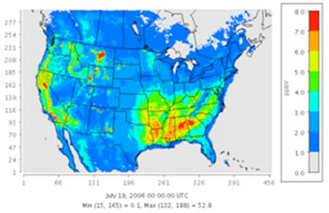
Air Quality Modeling
Technical Data Needed
AQ
M
O
D
E
L
I
N
G
Reference(s):
AirKnowledge:
https://airknowledge.gov/MODL-SI.html
Technical Work:
https://www.epa.gov/scram

Slide 117
Air Quality Modeling and SIPs
Technical Data Needed
AQ
M
O
D
E
L
I
N
G
CAA Section 172(c) requires States with an NAA to submit an attainment demonstration that uses:
Emissions Inventory (base and future years)
Adopted Control Measures
For PM2.5, all States (with NAAs) must submit an attainment demonstration which includes modeling (40 CFR §51.1007)
Photochemical grid modeling and/or local dispersion modeling
Precursor demonstrations to avoid precursor control measures
For ozone, moderate and above NAAs are required to submit an attainment demonstration with modeling (40 CFR §51.908)
Photochemical grid modeling

Slide 118
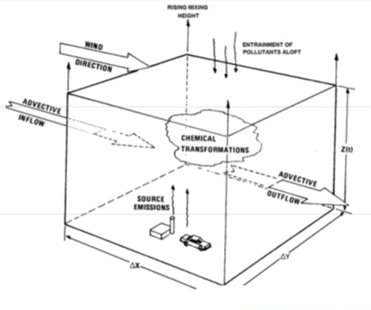
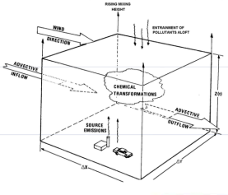
Photochemical Grid Models (PGM)
Technical Data Needed
AQ
M
O
D
E
L
I
N
G
Large-scale air quality models that account for chemical and physical atmospheric processes in predicting pollutant concentrations.

Slide 119
Photochemical Grid Modeling
Technical Data Needed
AQ
M
O
D
E
L
I
N
G
Simulate the multiple and complex chemical and physical processes that produce air pollution
Platforms for integrating multiple emissions source categories and emissions control strategies in a single simulation
The ultimate goal of PGMs is to assist policy makers in determining the most efficient ways of reaching a future air-quality goal.
Models are used to predict the effects of future control strategies
Controls necessary for SIP attainment demonstrations (States)
Air quality impacts of national rules (EPA)

Slide 120
Current Generation of PGMs
Technical Data Needed
AQ
M
O
D
E
L
I
N
G
“One-Atmosphere” Modeling
Multi-pollutant: Ozone, PM, visibility, acid and nutrients deposition, air toxics, etc.
Multi-scale: International, National, Regional, Local
Advanced Computing Technologies
Fast runtime (highly efficient for parallel & distributed computing) and cross-platform portability (supercomputers to PCs)
Examples include Comprehensive air Quality Model (CAMx) and Community Multi- scale Air Quality (CMAQ) model

Slide 121
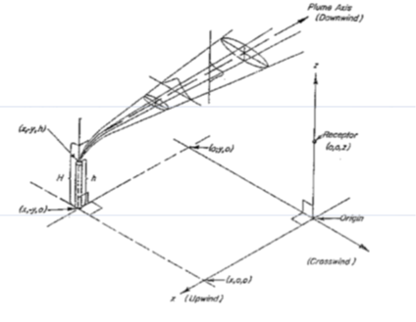
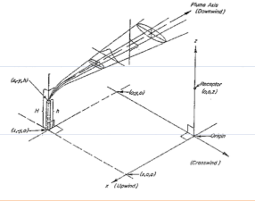
Dispersion Models
Technical Data Needed
AQ
M
O
D
E
L
I
N
G
Source-oriented models (ex: smelters) that characterize atmospheric processes by dispersing a directly emitted pollutant to predict concentrations at selected downwind receptor locations.

Slide 122
Dispersion Modeling
Technical Data Needed
AQ
M
O
D
E
L
I
N
G
Guideline on Air Quality “Appendix W” addresses requirements for PSD permit modeling
2022 and 2024 Guidance for ozone and PM2.5 permit modeling
https://www.epa.gov/scram/guidance-ozone-and-fine-particulate-matter-permit-modeling
Additional Resources
https://www.epa.gov/scram/clean-air-act-permit-modeling-guidance

Slide 123
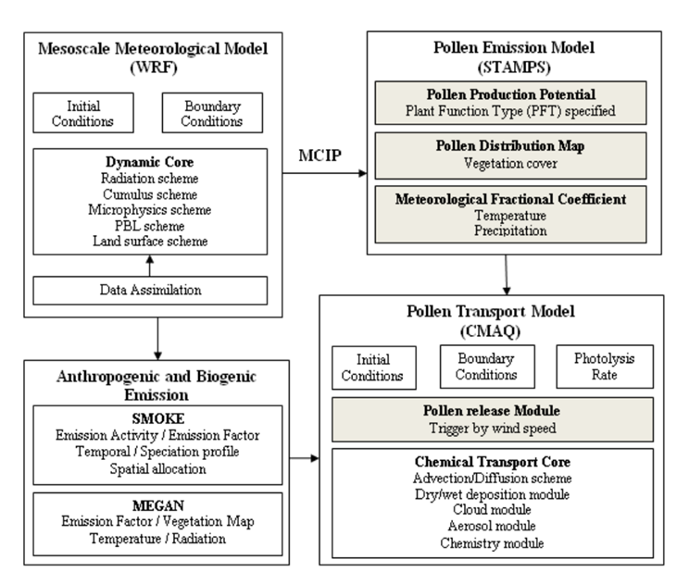
Overview: How models fit together
Pollen Example:
While the focus of this flow chart is modeling pollen, the concepts of how models fit together is the same as with AQ pollutant modeling

Slide 124
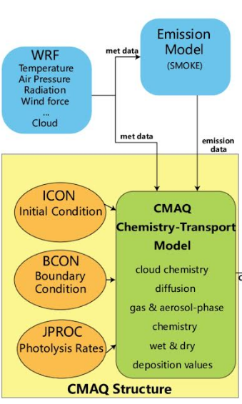
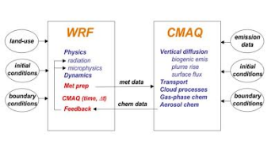
Overview: How models fit together (cont.)
These flow charts depict how emissions and meteorological models are used as inputs to the photochemical grid model

Slide 125
Model Inputs: Emissions
Technical Data Needed
AQ
M
O
D
E
L
I
N
G
For Ozone
Hourly gridded emissions of NOx, VOC, and CO
For PM2.5
Hourly gridded emissions of NOx, VOC, SO2, ammonia, CO, and speciated primary PM
Area and Nonroad: industrial equipment, aircraft, recreational marine, gasoline vapors from refilling, lawn mowers, etc.
Mobile: cars, trucks, buses, etc.
Point: utilities, refineries, etc.
Biogenic: certain tree and plant species emit ozone and PM precursors

Slide 126
Model Inputs: Meteorology
Technical Data Needed
AQ
M
O
D
E
L
I
N
G
Models need many meteorological variables (gridded, hourly) as input to simulate advection, diffusion, deposition, chemical transformation, etc.
Wind fields
Temperature
Moisture
Vertical diffusion or Planetary Boundary Layer (PBL) height
Use gridded data from a meteorological model such as the Weather Research & Forecasting (WRF) model
More information available at:
https://www.epa.gov/scram/air-modeling-meteorological-grid-models

Slide 127
Model Performance Evaluation
Technical Data Needed
AQ
M
O
D
E
L
I
N
G
Operational Evaluation: compare predicted concentrations to observed concentrations
Statistics (bias, error, etc.)
Scatterplots
Time series plots
If model performance is “acceptable” then the modeling system can be used to predict future air quality.

Slide 128
Future Year Predictions and Control Strategies
Technical Data Needed
AQ
M
O
D
E
L
I
N
G
Emissions are projected to a future year and the model is run again (the meteorology is held constant)
The difference between the base and future year is the predicted future air quality impacts
The model can be run again with alternative future year emissions control strategies
The base year is rooted in the modeling design value and the control scenarios use the model to predict future year expeditious attainment

Slide 129
Future Modeling Years
Technical Data Needed
AQ
M
O
D
E
L
I
N
G
Future modeling years depend on attainment dates and details contained in the O3 and PM2.5 implementation rules
PM2.5: 5-and 10-year deadlines under Subpart 1
O3: 3, 6, 9, 15, 17, and 20-year deadlines under Subpart 2
Generally model a future year which is one year prior to attainment deadline
Emissions controls need to be in place in the year or season prior to the deadline

Slide 130
Source Apportionment
Technical Data Needed
AQ
M
O
D
E
L
I
N
G
Regional air quality models include configuration options for tracking O3 and PM pollution precursor impacts on receptors
Distinct from observation-based receptor modeling
CMAQ (Community Multiscale Air Quality)
Integrated Source Apportionment Method (ISAM)
• CAMx (Comprehensive Air Quality Model with extensions)
Ozone Source Apportionment Tool (OSAT)
Particulate Matter Source Apportionment Tool (PSAT)
Anthropogenic Precursor Culpability Assessment (APCA)
Transport SIP and PSD applications

Slide 131
Model Improvements
Technical Data Needed
AQ
M
O
D
E
L
I
N
G
Advanced coupled version of WRF and CMAQ was developed and is used in the research community
Allows for real-time feedback between met and air quality models
https://www.epa.gov/cmaq/wrf-cmaq-model
Where to find the latest on models?
check out the Community Modeling and Analysis System (CMAS) at: https://www.cmascenter.org

Slide 132
Modeling Guidance for SIP Attainment Demonstrations
Technical Data Needed
AQ
M
O
D
E
L
I
N
G
EPA’s recommendations for grid-based air quality modeling for 2015 Ozone, 2012 PM2.5 and Regional Haze reasonable progress analyses.
Does not cover dispersion modeling of PM2.5 for nonattainment area NSR and PSD
Guideline on Air Quality Models “Appendix W” addresses requirements for permit modeling
https://www.epa.gov/scram/state-implementation-plan-sip-attainment-demonstration-guidance

Slide 133
Attainment Demonstration Software
Technical Data Needed
AQ
M
O
D
E
L
I
N
G
A new software called SMAT-CE (Software for the Modeled Attainment Test - Community Edition) is being formally released as a replacement for Model Attainment Test Software (MATS).
SMAT-CE replicates the same tests that are performed by MATS, with identical (or nearly identical) results. SMAT performs the ozone and PM2.5 attainment tests and calculates changes in future year visibility at Class I areas.
https://www.epa.gov/scram/photochemical-modeling-tools

Slide 134
Unmonitored Area Analysis (UAA)
Technical Data Needed
AQ
M
O
D
E
L
I
N
G
Calculate future year design values in unmonitored areas
Uses interpolated ambient design values and model output (fused data)
Supplemental analysis to the monitored based tests
MATS can create spatial fields needed for the UAA
Similar tests for O3 and PM2.5
UAA not designed to look for unmonitored PM micro-scale hotspot issues
12 km resolution sufficient for annual PM2.5
Finer resolution for 24-hr PM2.5 may be appropriate

Slide 135
Local Area Analysis (LAA)
Technical Data Needed
AQ
M
O
D
E
L
I
N
G
Focused on evaluating influence of primary PM2.5 at monitors
LAA provides a method to examine local primary PM source contributions at FRM monitors
Can use either dispersion model or fine grid Eulerian model (~1km?)
EPA recommends methods for adding secondary PM components from grid-based models with primary components from dispersion model

Slide 136
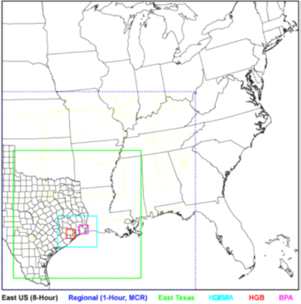
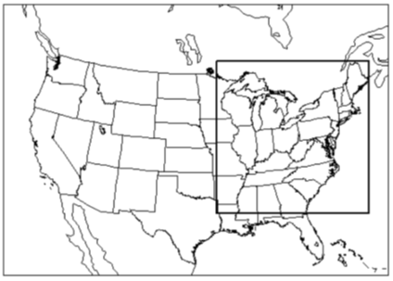


Example Modeling Domains
Technical Data Needed
AQ
M
O
D
E
L
I
N
G

Slide 137
What if your model has issues?
Technical Data Needed
AQ
M
O
D
E
L
I
N
G
Weight of Evidence -Weight of evidence (WoE) is used for additional modeling runs not specifically stated in the guidance, other technical studies, straying from the default model configuration.
WOE approaches (i.e. processes used to assess the evidence in support of a hypothesis) can and should be used as needed on any issue needing additional discussion or assessment.
When used in modeling, one application is the justification from deviating from model defaults.
Technical weight of evidence is usually found in the appendix to the SIP and referenced in the SIP body.
Coordination with EPA on what is needed within a weight of evidence is very important.
Documentation is critical.

Slide 138
Precursor Demonstration
Technical Data Needed
AQ
M
O
D
E
L
I
N
G
For PM2.5, rule allows a demonstration to avoid additional control measures on precursor specific pollutants
Two different type of precursor demonstrations
Source/Sector specific – tied to information directly related to a specific sector, such as industrial sources
Comprehensive – looks at all sectors combined
Developing demonstrations is complicated
Takes a lot of time and coordination with EPA
Needs a lot of data and modeling
EPA must approve prior to avoiding any control measures, which complicates timing of submittal of plans, implementation of control measures and approvability of plans.

Slide 139
PM2.5 Precursor Demonstration
Technical Data Needed
AQ
M
O
D
E
L
I
N
G
A precursor demonstration is a tiered analysis that can be broken down into five stages each with a decreasing level of confidence in the demonstration.
The various precursor demonstrations available are the following:
Concentration Based Analysis
Ambient Data
Air Quality Modeling (zero-out) - point source set to zero for SO2/NOx, all sectors set to zero only for NOx/all sectors set to zero for VOCs
Sensitivity Based Analysis (only if needed)
70% reduction
50% reduction
30% reduction
PM2.5 Precursor Demonstration Guidance (epa.gov): https://www.epa.gov/pm-pollution/pm25-precursor-demonstration-guidance

Slide 140
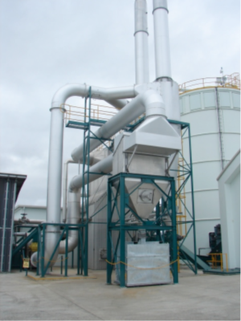
Control Strategies & Permits
Technical Data Needed
C
O
N
T
R
O
L
M
E
A
S
U
R
E
S
Reference(s):
AirKnowledge:
https://airknowledge.gov/PERM-SI.html
https://airknowledge.gov/PLAN-SI.html
Technical Work: https://www.epa.gov/ground-level-ozone-pollution

Slide 141
Control Strategies
Technical Data Needed
C
O
N
T
R
O
L
M
E
A
S
U
R
E
S
S/L/Ts have main responsibility to develop
There are several good sources to help
https://www.epa.gov/catc/about-clean-air-technology-center
Good starting point for RACT/BACT/LAER
National and Regional organizations:
−AAPCA https://cleanairact.org/
−NACAA http://4cleanair.org/
−CenSARA, LADCO, MARAMA, Metro 4/SESARM, NESCAUM, OTC, WESTAR/WRAP
https://censara.org/
https://metro4-sesarm.org/
www.westar.org
https://marama.org/

Slide 142
Control Strategy Development
Technical Data Needed
C
O
N
T
R
O
L
M
E
A
S
U
R
E
S
Steps
Determine priority pollutants
Identify control measure options
Work with potentially affected source groups and others to determine appropriate controls
Incorporate final control measures into SIP

Slide 143
Control Technologies
Technical Data Needed
C
O
N
T
R
O
L
M
E
A
S
U
R
E
S
Engineering and efficiency solutions for reducing air pollution from sources
The EPA Control Techniques Guidelines (CTGs) provides control technology options
Alternative Control Techniques Documents (ACTs) describe other available control technologies and their respective cost effectiveness
The Control Strategy Tool (CoST) integrates inventories, control technologies, and costs to develop control strategies

Slide 144
Reasonably Available Control Measures (RACM)
Technical Data Needed
C
O
N
T
R
O
L
M
E
A
S
U
R
E
S
Section 172(c)(1) of the CAA applies to all NAAs
EPA guidance interprets RACM provision to require a demonstration that:
State has adopted all reasonable measures to meet RFP requirements and to demonstrate attainment as expeditiously as practicable
No additional measures that are reasonably available will advance the attainment date or contribute to RFP for the area.

Slide 145
Reasonably Available Control Technology (RACT)
Technical Data Needed
C
O
N
T
R
O
L
M
E
A
S
U
R
E
S
Subset of RACM
Minimum requirement for existing sources
Lowest Achievable Emissions Rate (LAER) is applied to new or modified sources
EPA RACT definition (not in the CAA):
“the lowest emission limitation that a particular source is capable of meeting by the application of control technology that is reasonably available considering technological and economic feasibility” (44 FR 53762; September 17, 1979).
NAA SIPs must demonstrate the application of RACT in the attainment plan emissions control strategies

Slide 146
BACM/BACT and MSM
Technical Data Needed
C
O
N
T
R
O
L
M
E
A
S
U
R
E
S
BACM = Best Available Control Measure
BACT = Best Available Control Technology
MSM = Most Stringent Measures
Similar process to determining RACM/RACT, but for serious and severe NAA areas
Regulatory mechanism could be an air quality permit, consent order, source specific regulation or other mechanism

Slide 147
5% Reduction
Technical Data Needed
C
O
N
T
R
O
L
M
E
A
S
U
R
E
S
Continued failure to reach attainment by statutory deadline
Must show a 5% reduction in the emissions budget per year until reach attainment
Final requirement to try to ensure attainment in a timely manner
Alaska: Fairbanks North Star Borough Serious PM2.5 Nonattainment Area latest area to reach this threshold.

Slide 148
Contingency Measures
Technical Data Needed
C
O
N
T
R
O
L
M
E
A
S
U
R
E
S
SIPs must provide for the implementation of measures if an area fails to attain the NAAQS or make RFP
Must be identified, but not necessarily in place at the time the SIP is submitted to EPA
Estimated emission reductions must equal 3% of VOC or NOx emissions beyond the levels needed for attainment or RFP goal
https://www.epa.gov/air-quality-implementation-plans/final-contingency-measures-guidance

Slide 149
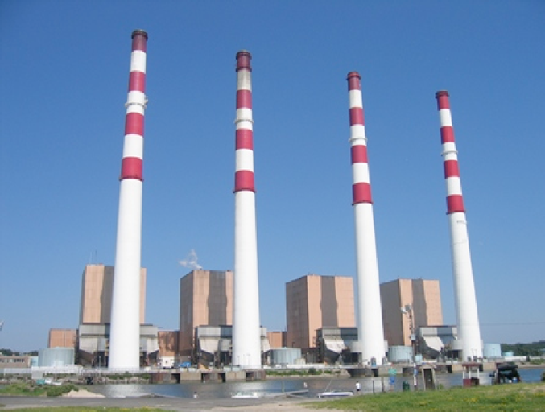
New Source Review (NSR)
Technical Data Needed
C
O
N
T
R
O
L
M
E
A
S
U
R
E
S
Training:
AirKnowledge: https://airknowledge.gov/PERM-SI.html
Technical Work:
https://www.epa.gov/nsr/learn-about-new-source-review
https://www.epa.gov/catc

Slide 150
Three types of NSR permits
Technical Data Needed
C
O
N
T
R
O
L
M
E
A
S
U
R
E
S
Nonattainment NSR permits are required for new major sources/major source modifications in nonattainment areas
Prevention of Significant Deterioration (PSD) permits are required for new major or major sources making modifications in attainment and maintenance areas
Minor source NSR permits applied in attainment or maintenance areas to help ensure there is no violation of a NAA’s attainment plan
A permit is generally required prior to construction of the source

Slide 151
NSR Goals
Technical Data Needed
C
O
N
T
R
O
L
M
E
A
S
U
R
E
S
Economic growth can proceed without creating any new nonattainment problems
Public health and welfare are protected from any adverse effect which might occur even at air pollution levels better than the NAAQS
Preserve, protect, and enhance the air quality in areas of special natural recreational, scenic, or historic value, such as national parks and wilderness areas.
EPA issues NSR permits on Federal Lands and where states don’t have approved programs

Slide 152
Which pollutants are regulated under NSR?
Technical Data Needed
C
O
N
T
R
O
L
M
E
A
S
U
R
E
S
Criteria Air Pollutants:
CO, SO2, VOC, NOx, NO2, Pb, PM2.5 and PM10
Some pollutants not covered by NAAQS are subject to PSD
GHGs - https://www.epa.gov/nsr/clean-air-act-permitting-greenhouse-gases
Total PM
Fluorides, sulfuric acid mist, reduced sulfur compounds
Metals
HAPs are not covered

Slide 153
What Does NSR/PSD Determine?
Technical Data Needed
C
O
N
T
R
O
L
M
E
A
S
U
R
E
S
Defines what measures will be used to control new air pollution emissions from a facility:
Lowest Achievable Emissions Rate (LAER)
For nonattainment areas
Does not consider cost, energy, or other environmental factors
Best Available Control Technology (BACT)
For PSD areas, i.e. attainment areas
Considers cost effectiveness of control options
Not an annual limit; BACT is a short-term limit (lbs/hour)
Rate may be in a permit or regulation

Slide 154
Potential to Emit (PTE)
Technical Data Needed
C
O
N
T
R
O
L
M
E
A
S
U
R
E
S
The maximum capacity of a source to emit a pollutant under its physical and operational design
Based on operating 8760 hours/year, unless restricted by a permit condition or some other physical restriction
Can include effects of emissions controls, if enforceable by permit or:
State Implementation Plan (SIP),
Tribal Implementation Plan (TIP) or
Federal Implementation Plan (FIP) conditions

Slide 155
NSR nonattainment area permit requirements
Technical Data Needed
C
O
N
T
R
O
L
M
E
A
S
U
R
E
S
Emissions reductions from existing sources to balance emissions from proposed new or modified sources
Offset must be at least 1:1
Emissions offsets reductions must be:
Quantifiable, enforceable, permanent and surplus (QEPS)
From actual emissions – real, no “paper” reductions
From authorized emissions sources
Federally enforceable at the time of permit issuance for new or modified source
In effect before the new source can commence operation

Slide 156
PSD Permit Requirements
Technical Data Needed
C
O
N
T
R
O
L
M
E
A
S
U
R
E
S
Main requirements
Install Best Available Control Technology (BACT)
Perform air quality analysis to assess impacts on air quality; ensure air quality in clean areas does not degrade
Perform additional impacts analysis
Assess impacts on national parks & wilderness areas
Assess impacts on soil & vegetation
Assess other air quality-related values
Allow for opportunities for public involvement

Slide 157
PSD Permit Requirements, cont.
Technical Data Needed
C
O
N
T
R
O
L
M
E
A
S
U
R
E
S
In 2019, EPA introduced MERPs (Modeled Emission Rates for Precursors)
Intended to help states with PSD permitting by creating MERP “bubbles”
https://www.epa.gov/nsr/guidance-development-modeled-emission-rates-precursors-merps-tier-1-demonstration-tool-ozone

Slide 158
28 Source Categories subject to the PSD 100 TPY Threshold
Technical Data Needed
C
O
N
T
R
O
L
M
E
A
S
U
R
E
S
Coal cleaning plants
Kraft pulp mills
Portland cement plants
Primary zinc smelters
Iron and steel mills
Primary aluminum ore reduction plants
Primary copper smelters
Municipal incinerators
Hydrofluoric acid plants
Sulfuric acid plants
Nitric acid plants
Petroleum refineries
Lime plants
Phosphate rock processing plants
Coke oven batteries
Sulfur recovery plants
Carbon black plants
Primary lead smelters
Fuel conversion plants
Sintering plants
Secondary metal production plants
Chemical process plants
Fossil-fuel or combination of boilers
Petroleum storage/transfer units
Taconite ore processing plants
Glass fiber processing plants
Charcoal production plants
Fossil fuel fired steam electric plants

Slide 159
PSD SIP Requirements
Technical Data Needed
C
O
N
T
R
O
L
M
E
A
S
U
R
E
S
All pollutant-emitting activities from major stationary sources:
Same industrial group (same SIC code)
Contiguous or adjacent properties
Common ownership or control
Defining modification
All units with physical or operational change
Few exclusions
Routine maintenance repair and replacement
Increase in hours of operation*
Artificial separation of a project is not allowed

Slide 160
PSD Additional Impact Assessment and Class 1 Areas
Technical Data Needed
C
O
N
T
R
O
L
M
E
A
S
U
R
E
S
Analyze impacts on soils, vegetation, and visibility
PSD provides special treatment for Class 1 areas including certain national parks, and national wilderness areas
Federal Land Manager defines Air Quality Related Values (AQRVs)
Establish criteria for adverse impacts
Determine if a source will adversely impact AQRV’s
Make recommendation to the permitting agency
Permitting authority makes the final decision

Slide 161
PSD Regulations and Guidance
Technical Data Needed
C
O
N
T
R
O
L
M
E
A
S
U
R
E
S
Regulations:
40 CFR 51.166: Specifies the minimum requirements that a PSD air quality permit program under Part C of the Act must contain in order to warrant approval by EPA as a revision to a State implementation plan (SIP).
40 CFR 52.21: Delineates the federal PSD permit program, which currently applies as part of the SIP, in approximately one third of States that have not submitted a PSD program meeting the requirements of 40 CFR 51.166.

Slide 162
Plant-wide Applicability Limits (PALs)
Technical Data Needed
C
O
N
T
R
O
L
M
E
A
S
U
R
E
S
Permit mechanism to avoid NA NSR/PSD in future for an existing source
Pollutant specific
If total emissions after a modification are below the PAL, PSD is not triggered
Effective for 10 years
https://www.epa.gov/nsr/plantwide-applicability-limit-pal-emissions-level

Slide 163
Who can you go to in your organization for technical support?
Technical Data Needed
H
O
M
E
W
O
R
K
Look at organization charts
Find those responsible for the monitors and submitting data to AQS
Find those responsible for issuing permits to the major sources that will be impacted
Find out if you have on-staff modelers, and what models they know.
No staff?
Find those who are responsible for contracting support!
COMMUNICATE TIMELINES EARLY

Slide 164
SIP Preparation
SIP Preparation

Slide 165
Preparations for Starting a SIP
SIP Preparation
Do you have answers to the following questions?
Can you define the problem, and know the source(s)?
Do you have data readily available or do you need to gather data?
What resources do you have to develop the SIP, in-house staff, funding?
Do you currently have the authority to issues regulations to address the problem or must you get the regulatory authority?
How well does your administration or the local administration understand the problem?

Slide 166
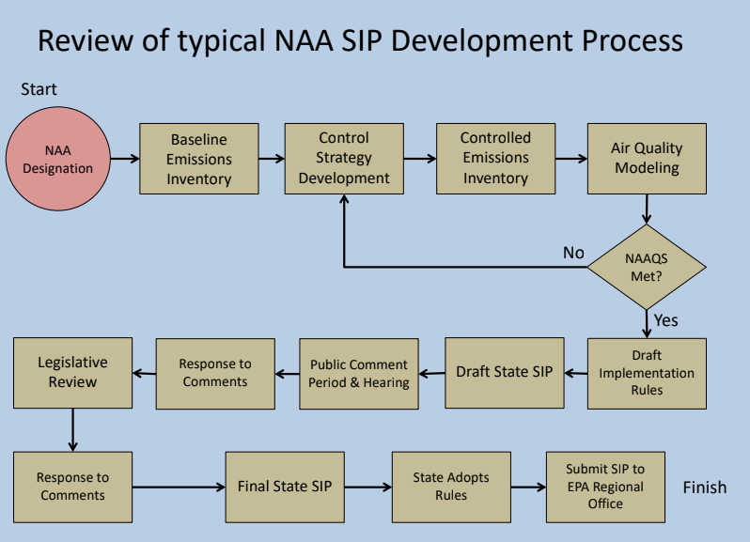
Drafting and Finalizing a SIP Local/State Processes
SIP Preparation

Slide 167
Communications with EPA
SIP Preparation
Working with Regional EPA Staff very important
Start discussions early
Get agreement on the following documents to avoid issues in the future
SIP Development Plan
TAP – Technical Analysis Protocol
IPP - Inventory Preparedness Plan
EPA Checklist
DOCUMENT, DOCUMENT, DOCUMENT

Slide 168
Communications with EPA
SIP Preparation
SIP Development Plan
Basic schedule overview for EPA to assist with their planning and help get everyone on the same page
Identifies potential controversial issues
Identifies responsible parties – state, local, contractor, EPA

Slide 169
Communications with EPA, cont.
SIP Preparation
TAP – Technical Analysis Protocol
Documents what models will be used (year and version)
Documents and provides rationale for model choices and versions
Documents any model adjustments made for unique issues or circumstances.
Living document that grows and is modified over time
Provides historical information in case of EPA staff turnover
Can include agreements to minimize adverse pressure for changes
Can be incorporated in the SIP appendix to give background information

Slide 170
Communications with EPA, cont.
SIP Preparation
IPP - Inventory Preparedness Plan
Document that lays out the plan for developing the inventories.
Where data will come from – Source tests, surveys, NEI, etc.
What years will be used
How the data will be QA/QCd.
Can assist in the development of ‘weight of evidence’ – identifying information or data that doesn’t ‘fit’ into specific requirements for emission inventories or modeling but is important to the area

Slide 171
Communications with EPA, cont.
SIP Preparation
EPA Checklist
Typically regional office develops checklists they will use to evaluate SIPs for the completeness check
Ask if you can get a copy of the checklist to assist in ensuring that nothing is missed

Slide 172

EPA’s SIP LEAN Process
SIP Preparation

Slide 173
EPA LEAN Process – 2 Toolkits
SIP Preparation
https://www.epa.gov/sites/default/files/2013-10/documents/leanenvirotoolkit.pdf
General Toolkit for efficiencies and reduction of environmental waste
State Implementation Plan (SIP) Lean Toolkit for Collaboration Between EPA and Air Agencies (copy will be emailed around)
Focus on SIPS, lays out recommendations and process with example templates
Two main goals – early engagement and ensuring EPA has opportunity to review full SIP/SIP amendment prior to official public comment period.
In SIP 101 course, templates were built from the EPA SIP LEAN Toolkit
https://www.epa.gov/air-quality-implementation-plans/state-implementation-plan-sip-lean-toolkit-collaboration-between

Slide 174
SIP LEAN – Early engagement
SIP Preparation
Key to any SIP work is identifying schedule, roles and responsibilities, and issues and concerns.
Filling out a:
SIP Development Plan (timeline, responsibilities, questions and issues document) – aligns with LEAN approach
Technical Analysis Protocol – TAP - (how modelling will be conducted (if needed), what models will be used, etc) – not identified specially in LEAN, but will help with technical issues
Inventory Preparedness Plan (IPP) – (what data will be used in the SIP and how it will be collected) – could be important to determining SIP development timelines as some data may take longer to collect – not identified specially in LEAN, but will help with technical issues

Slide 175
SIP LEAN - communications/process
SIP Preparation
EPA wants a number of commitments for the Early Engagement Draft (ie. pre–Public Notice Draft of SIP/SIP Amendments):
Notification of when an agency will have an early draft submission ready
An agency will submit an early engagement draft of the full SIP/SIP amendment
EPA wants time to review the full draft and provide comments – they will provide comments within an agreed-upon timeframe in a manner an agency prefers, but typically in writing.
Agency addresses EPA’s comments through edits within the early engagement draft
Agency is ready to release for public comment (EPA will likely also comment formally during this period as well)

Slide 176
Drafting and Finalizing a SIP State/Local Processes
SIP Preparation
Develop/Track/Fine Tune Timelines
Expand initial timeline development (demonstration - example tool)
Data requests and data gathering
Prep development work (SIP Dev Plan, IPP, TAP)
Developing policy recommendations based on technical info and local situation
To assist policy - knowing EPA’s stance is very helpful (see Preparations for Starting A SIP)
Engaging local jurisdictions, stakeholders, FLMs (if required/appropriate), public and incorporating feedback [don't wait until public comment period for feedback and input]
Local/State/Tribal processes for adopting rules, plans

Slide 177
SIP Submittal
SIP Submittal

Slide 178
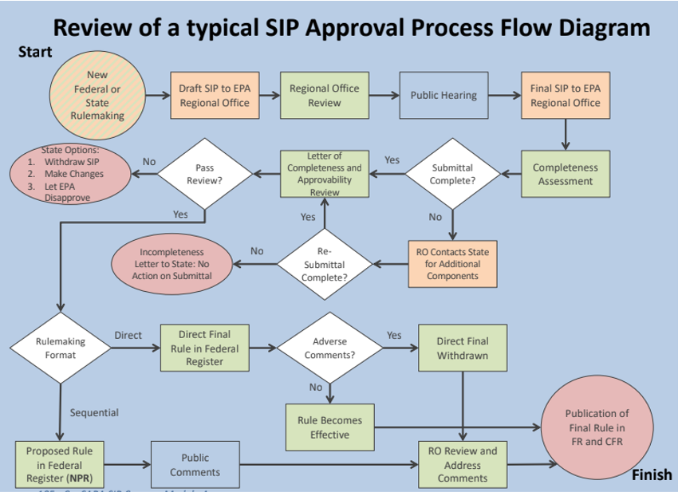
What happens after you have the SIP complete at the state/local/Tribal level?
SIP Submittal

Slide 179
EPA Electronic SIP Submission System (eSIP)/State Planning Electronic Collaboration System (SPeCS)
SIP Submittal
Allows State to upload draft and submissions, supplemental information and withdraw SIPs.
State and EPA staff can track the SIP submittal process.
A state can alternatively submit paper version
Must be accompanied by an electronic duplicate.
https://www.epa.gov/air-quality-implementation-plans/submit-sips-online

Slide 180
40 CFR 51 Appendix v
SIP Submittal
Criteria for Determining the Completeness of Plan Submission
“The EPA shall return to the submitting official any plan or revision thereof which fails to meet the criteria set forth in Appendix v, and request corrective action, identifying the components absent or insufficient to perform a review of the submitted plan.”

Slide 181
40 CFR 51 Appendix v, cont.
SIP Submittal
Allows for parallel processing of a SIP
SIP submission before a state officially adopts it.
State must specifically request.
State must include the related draft/proposed regulation.
Details submission requirements
No confidential business information should be included, and identification of copyrighted materials is necessary.

Slide 182
40 CFR 51 Appendix v, cont.
SIP Submittal
SIP must include administrative materials:
The State’s formal request for EPA to approve the SIP.
Proof of adoption of the SIP and regulations or other form of control measures.
Proof of public hearing(s) and response to comments.
SIP must include technical support documents:
Modeling platform, including documentation of software and data used in modeling.
Evidence that RACT/RACM are met.
Evidence that emissions limits will be met.

Slide 183
EPA staff involved in SIP reviews
SIP Submittal
EPA Regional Administrators (RA) are delegated the authority to receive, return, approve, or disapprove SIPs.
Review, evaluation, rulemaking are done at the regional level.
Caveats
EPA Offices of General Counsel and Regional Council must review Federal Register Notice responses to comments received during NPR public comment period.
SIP Consistency Process may be required if the action is breaking new ground or departs from previous EPA decisions; a pre-decisional, internal EPA deliberative process.

Slide 184
Federal Register – the daily journal of the U.S. Government
SIP Submittal
https://www.federalregister.gov/
No subscription fee – includes all federal agencies’ regulatory actions.
Can search 1994 to present.
Final rules are categorized in the Code of Federal Rules (CFR).
Most states have something similar for state regulatory actions.

Slide 185
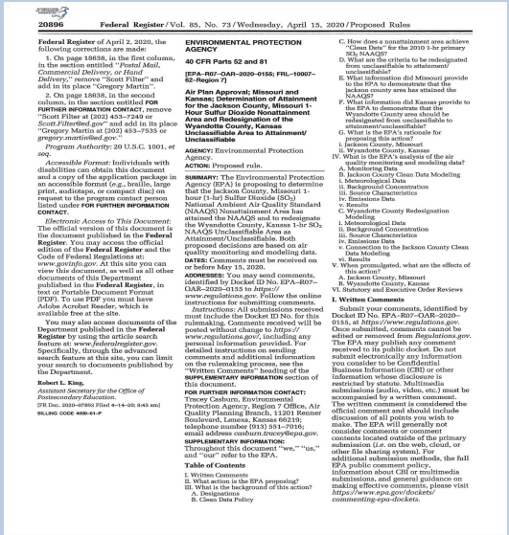
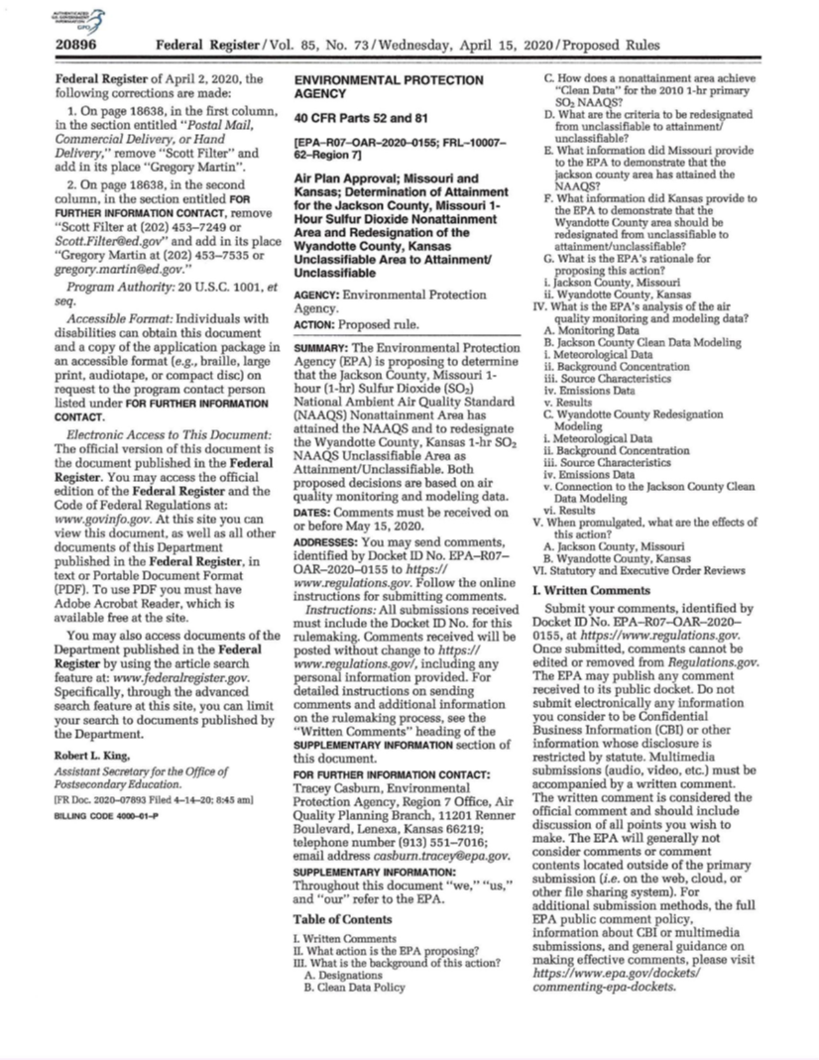
Federal Register
SIP Submittal

Slide 186
Public Comments
SIP Submittal
All official correspondence received by EPA in accordance with a notice of proposed rulemaking (NPR) in the FR become part of the EPA rulemaking docket.
Comments received before the submissions of a SIP revision are not considered in the EPA rulemaking.
EPA rulemaking is only based on the formal SIP submission and comments received during the comment period.
Exceptions for late comments are at EPA’s discretion.
The NPR can state that late comments will not be accepted.

Slide 187
Final Rulemaking Notice
SIP Submittal
EPA Regional Office prepares the final rulemaking notice (FRN).
Considers all relevant comments received after the NPR.
Preamble in the FRN includes a response-to-comment section.
The plan is promulgated 30-days after the FRN.
Can be exceptions for good cause offering a shorter effective date.

Slide 188
EPA Action Options
SIP Submittal
Disapproval
Sanctions clock starts for the state to correct the deficient SIP.
Limited Approval
SIP revision satisfies some requirements but is not fully approvable and may result in start of FIP and/or sanction clocks.
Conditional Approval
SIP may be approved if the state commits to adopt control measures within 1 year. Avoids sanctions, but if state doesn’t follow through, disapproval is likely and sanctions clock starts.
Full Approval
Submitted SIP meets all requirements and EPA approves with no clocks for future action.
Approved SIP contents become federal law and can only be changed through additional SIP revision(s).

Slide 189
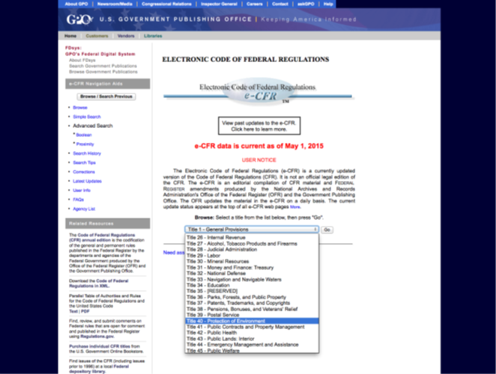

Code of Federal Regulations Title 40 (Part 52) Approval and Promulgation of SIPs
SIP Submittal
Record of the EPA Administrator’s approval, disapproval, and promulgation of State SIPs.
Every State/Tribe/Territory has its own subpart under Part 52.
Promulgation - the act of formally proclaiming or declaring a new law after its enactment.
For U.S. environmental regulations formal promulgation occurs after EPA considers all public comments received on the proposal and follows publication of the final rule in the Federal Register (Part 52).

Slide 190
Federal Implementation Plan (FIP)
SIP Submittal
24 months after EPA disapproves or makes a finding of failure to submit a required plan, it has nondiscretionary duty to promulgate a FIP.
The FIP should correct the deficiency in the SIP; no more, no less.
Partial FIP is a possibility.
Sanctions clock is turned off only after EPA approves a SIP revision that corrects the deficiency.

Slide 191
What else can happen if a State misses a SIP deadline?
SIP Submittal
Sanctions kick in:
EPA Administrator may apply discretionary sanctions (CAA 110(m)).
Mandatory sanctions (CAA 179) may also apply -
Increased emissions offsets for new or modified sources
Transportation program restrictions
Sanctions triggered by:
Finding of failure to submit a complete SIP
Finding of failure to implement any element of an approved SIP
Disapproval of a SIP
Failure to submit a SIP revision for which EPA has issued a SIP call or disapproval notice

Slide 192

What happens after the 20-year maintenance plan?
SIP Submittal

Slide 193
Background – Redesignation To Attainment
SIP Submittal
Monitors Show Attainment
Agency Submits Redesignation Request and Maintenance Plan – First 10 years
Agency Submits SIP Update – Second 10 Years
Only after EPA fully approves Maintenance SIP does the first 10-year clock start
Only after the EPA fully approves the SIP Update does the second 10-year clock start

Slide 194
Procedures for processing requests to Redesignate Areas to Attainment
SIP Submittal
September 8, 1992 Memorandum from John Calcagni, entitled Procedures for processing requests for Redesignate Areas to Attainment
Memo Lists 5 requirements:
EPA has determined that the NAAQS standards have been attained
The applicable implementation plan has been fully approved by EPA under section 110(k)
EPA has determined that the improvement in air quality is due to permanent and enforceable reductions in emissions
The state has met all applicable requirements for the area under section 110 and Part D
EPA has fully approved a maintenance plan, including a contingency plan for the area under section 175A

Slide 195
Successful conclusion of 20 years in maintenance
SIP Submittal
Acknowledgement of completion from EPA (confirm with local EPA on format this will take)
Acknowledgement that Conformity is no longer required (confirm with local EPA on format)
Area may or may not be eligible for Federal Highway Administration (FHWA) Congestion Mitigation and Air Quality (CMAQ) funding (confirm specific project(s) w FHWA)
Approved Contingency measure plan – still in effect, so all control measures that were converted to contingency measures must still be available to be ‘turned on’ if there are violations of the NAAQS
Regulations and statutes must be maintained

Slide 196
Compliance and Enforcement
Compliance & Enforcement

Slide 197

Compliance and Enforcement of SIPs
Compliance & Enforcement
Reference(s):
Training:
https://airknowledge.gov/index.html
Technical Work:
https://www.epa.gov/enforcement/air-enforcement

Slide 198
State’s Compliance Role After a SIP is Approved by EPA
Compliance & Enforcement
Continuation of air quality monitoring
There may be monitoring requirements for sources too – such as continuous emissions monitoring and stack testing.
Enforcement of state rules, permits, other control strategies
May involve site visits and source submittal of periodic reports.
State submits its own periodic reports to EPA, as required

Slide 199
EPA’s Compliance Roles Compliance Monitoring Strategy (CMS)
Compliance & Enforcement
https://www.epa.gov/compliance/clean-air-act-caa-compliance-monitoring
Provides a national strategy to supplement state enforcement activities for stationary sources.
Provides States with flexibility to address local air pollution and compliance concerns.
Provides a framework for developing compliance monitoring programs that focus on achieving results.

Slide 200
Enforcement Civil Actions
Compliance & Enforcement
Civil liability arises simply through the existence of a violation; no requirement for prior knowledge or intent.
Civil Administrative Actions: notice of violation or an order (with or without penalties) directing an entity to take action to come into compliance.
Civil Judicial Actions: court filing against entities that have failed to comply with statutory/regulatory requirements or comply with an administrative order.

Slide 201
Enforcement Civil Actions, cont.
Compliance & Enforcement
Possible Outcomes:
Settlements may include consent agreements/final orders, administrative orders on consent, or consent decrees.
Penalties are designed to recover the economic benefit of noncompliance and to compensate for the seriousness of the violation.
Injunctive Relief forces a regulated entity to perform or refrain from performing some designated action.
Supplemental Environmental Projects are environmental improvement projects that violators voluntarily agree to perform.

Slide 202
Enforcement Criminal Actions
Compliance & Enforcement
Criminal liability is triggered through a demonstration of intent to violate NAAQS.
Reserved for the most egregious violations that are willful or knowingly committed.
Possible Outcomes:
Criminal Penalties are fines imposed by a judge at sentencing; may include restitution to those affected by the violation
Incarceration

Slide 203
SIP Challenges Citizen Suits
Compliance & Enforcement
The Clean Air Act (CAA)includes provisions that allow citizens to sue EPA when EPA fails to perform an act or duty required by the statute.
The CAA was the first environmental law in the U.S. to allow citizen suits.
Plaintiffs must provide the EPA with a Notice of Intent (NOI) to sue in advance of a lawsuit.

Slide 204
SIP Challenges Citizen Suits, cont.
Compliance & Enforcement
Under U.S. Code Title 42 §7604, citizens may sue:
Any person, including the U.S. government, or other governmental agency for violating emission standards.
The EPA Administrator for failing to perform any nondiscretionary act or duty under the CAA.
Entities proposing to construct new or modified facilities without the proper permits.

Slide 205
SIP Challenges Citizen Suits, cont.
Compliance & Enforcement
Requirements
Citizens must be adversely impacted by violation.
Violators, State, and EPA must have a 60-day notice of the alleged violation.
Violators may use the 60-day period to correct and give EPA or State an opportunity to enforce compliance.

Slide 206
SIP Challenges Citizen Suits, cont.
Compliance & Enforcement
CAA 304(a)(1) may be used to enforce standards and limits in the current SIP, even if there is a pending SIP revision submitted to EPA.
CAA 304(a)(2) confers citizen suit authority to compel EPA to make findings and promulgate a FIP for SIP revisions that have not been submitted.

Slide 207
SIP Challenges Lawsuits
Compliance & Enforcement
If EPA acts on a SIP revision, the EPA rulemaking is subject to challenge under the Administrative Procedure Act (APA) as a final action.
Venue is a Federal Court of Appeals.
If EPA fails to act on a SIP revision within 12 months of completeness determination or if a rule is challenged as unlawful then EPA is subject to lawsuit.
Venue is a Federal District Court.

Slide 208
SIP Challenges Lawsuits, cont.
Compliance & Enforcement
Court Options
Vacate and Remand: Rule or plan is no longer in effect.
Remand without Vacating: Rule or plan remains in effect, but EPA will need either to re-propose or recommence final action.
Remand with Partial Vacate: If possible, remove the defective part of the rule or plan.
Uphold: Permit the rule or plan to remain in effect as promulgated.

Slide 209
Final Review
Final Review

Slide 210
Status of NAAQS Reviews (from EPA August 2024)
 | Lead | Ozone | PM¹ | Secondary (Ecological) NO₂, SO₂, PM² | Primary NO₂ | Primary SO₂ | CO
Last Review Completed (final rule signed) | Sep 2016 | Dec 2020 | Dec 2020/Feb 2024 | Mar 2012 | Apr 2018 | Feb 2019 | Aug 2011
Recent or Upcoming Major Milestone(s) | Feb 7, 2024 Final ISA³ released Early 2025 Draft PA³ | May 2024 Science Policy Workshop Fall 2024 IRP³ Volumes 1 and 2 | March 6, 2024 Final Rule, effective May 6, 2024 | April 3, 2024 Proposed Rulemaking Dec. 10, 2024 Final Rulemaking (consent decree) | Mar. 18, 2024 IRP³ Volumes 1 and 2 Fall 2025 Draft ISA³ and IRP³ Volume 3 | TBD⁴ | TBD⁴
Additional information regarding current and previous NAAQS reviews is available at: http://www.epa.gov/ttn/naaqs/
¹ Combined primary and secondary (non-ecological effects) review of PM
² Combined secondary (ecological effects only) review of NO₂, SO_{2,} and PM
³ PA – Policy Assessment; REA – Risk and Exposure Assessment; IRP – Integrated Review Plan; ISA – Integrated Science Assessment
⁴ TBD = To be determined

Slide 211
State Planning Milestones (from EPA - August 2024)
Pollutant (Standard) | Final NAAQS/EG Signature | Nonattainment Designations Effective | Infrastructure SIP Due | Attainment/EG Plans Due | Attainment Date/EG Compliance Date
Ozone (2015) | Oct 2015 | Aug 3, 2018 * | Oct 2018 | Aug 2021-2022, Jan 2023, Jan 2026** | Aug 2021, 2024, 2027, 2033, 2038 *
Ozone (2008) | Mar 2008 | July 2012 | Mar 2011 | July 2015/2016 Jan 2017, Aug 2020, May 2024*** | July 2015, 2018, 2021, 2027, 2032
SO₂ (proposed annual secondary) | December 2024 (CD deadline) | TBD | December 2027 if NAAQS is revised | TBD | TBD
SO₂ (2010 1-hr primary) | June 2010 | ¹Oct 2013, ²Sept 2016, ³Apr 2018, ⁴Apr 2021 | June 2013 | ¹Apr 2015, ²Mar 2018, ³Oct 2019, ⁴Oct 2022 | ¹Oct 2018, ²Sept 2021, ³Apr 2023, ⁴Apr 2026
PM_{2.5} (2024 annual) | February 2024 | Spring 2026 | February 2027 | Fall 2027 | Spring 2032 (Moderate)
PM_{2.5} (2012 annual) | Dec 2012 | Apr 2015 | Dec 2015 | Oct 2016 (Moderate) | Dec 2021 (Moderate) Dec 2025 (Serious)
PM_{2.5} (2006 24-hr) | Oct 2006 | Dec 2009 | Oct 2009 | July 2011 | Dec 2015 (Moderate) Dec 2019 (Serious)
OOOOc Oil & Gas Emiss. Guideline | March 2024 | n/a | n/a | March 2026 | March 2029
UUUUa EGU Emiss. Guideline | April 2024 | n/a | n/a | April 2026 | April 2029
* September 24, 2018 for San Antonio, TX. Attainment dates are also September 24 of listed years.
** January 2023 for areas reclassified from Marginal to Moderate. Tentatively January 2026 for areas reclassified from Moderate to Serious.
***January 2017 for areas reclassified from Marginal to Moderate. August 2020 for areas reclassified from Moderate to Serious. May 2024 for areas reclassified from Serious to Severe.

Slide 213
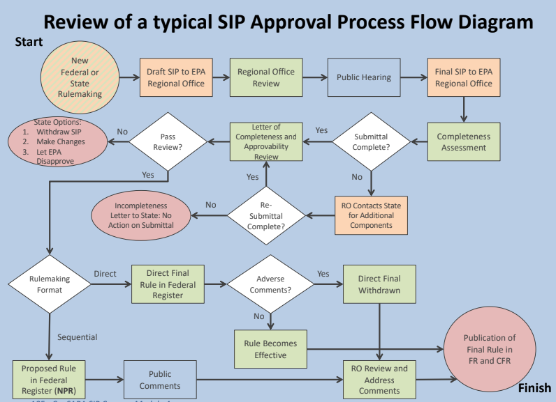

Slide 214
Additional Resources
Final Review
EPA Green Book (Nonattainment Area classifications and status)
https://www.epa.gov/green-book
Air Topics
https://www.epa.gov/environmental-topics/air-topics
SIP Lean Toolkit
https://www.epa.gov/air-quality-implementation-plans/state-implementation-plan-sip-lean-toolkit-collaboration-between
EPA SIP Guidance (websites with links to guidance, policies, process, etc)
https://www.epa.gov/air-quality-implementation-plans
https://www.epa.gov/air-quality-implementation-plans/develop-air-quality-sip#guidance
https://www.epa.gov/title-v-operating-permits/epa-process-manual-caa-requests-under-111b-111d-112-and-129

Slide 215
Additional Resources, cont.
Final Review
Compliance and Enforcement
https://www.epa.gov/enforcement/clean-air-act-caa-and-federal-facilities
https://www.epa.gov/enforcement/enforcement-policy-guidance-publications
Permit Modeling Guidance
https://www.epa.gov/scram/clean-air-act-permit-modeling-guidance
New Source Review
https://www.epa.gov/nsr
Transportation Conformity
https://www.epa.gov/state-and-local-transportation
Redesignation and Clean Data Policy
https://www.epa.gov/ground-level-ozone-pollution/redesignation-and-clean-data-policy-cdp

Slide 216
Regional/National Organization Contacts
AAPCA - Morgan Dickie: mdickie@csg.org; website: https://cleanairact.org/
NACAA - Loralei HoJay: lhojay@4cleanair.org; website: https://www.4cleanair.org/
CENSARA - Michael Vince: mvince@censara.org (get on email lists for quarterly meetings for planning)

Slide 217
Instructor Email Contacts
Cindy Heil: cindy.heil@outlook.com
Alice Edwards: ale2akclub@gmail.com

