Slide 1
Excel Statistics
240 CenSARA
Instructor: Steve Hiebsch
Email: steve.hiebsch@gmail.com

Slide 2
Course’s Agenda
Time | Day 1 | Day 2 | Day 3
8:30 – 8:50 | Set up Check-In | Check-In & Review Day 1 | Check-In & Review Day 2
8:50 – 9:40 | Introductions Pre-Test | Module 3 Central Tendency | Module 5 Linear Regression
9:40 – 10:35 | Module 1 Excel Basics | Module 3 Practice | Module 5 Practice
10:35 – 10:50 | Break | Break | Break
10:50 – 11:40 | Module 2 Describing Data | Module 4 Est & Confidence Interval | Module 6 Lognormal Distribution
11:40 – 12:30 | Module 2 | Module 4 Practice | Module 6 Practice
12:30 – 12:50 | Practice | Review | Post-Test
12:50 – 1:00 | Q&A over day | Q&A over day

Slide 3
Introductions
Introduce yourself
Name and position
Education and/or work background
Something more personal about yourself e.g. hobbies, special talent, something you accomplished of which you are proud, something nobody knows about you, etc. (optional)

Slide 4
Start Pre-Test
Open Microsoft Word file named “0 Pre-Test Excel…” on the Website for this course. Then follow the instructions.
Pre-Test 240CenSARA

Slide 5
Purpose of Class
Emphasis is on learning to use Microsoft Excel for statistical purposes.
While we will have some amount of statistical learning, this is not the main emphasis.
We will use some environmental type data, but again that is not the primary purpose.
Primary Purpose is to prepare student for some classes where there is need to use Excel in specific Statistical Analysis.

Slide 6
Module 1: Using Microsoft Excel Worksheets
After completing this module, the student will be able to:
Understand why Excel is useful as a statistical tool
Define what is meant by a worksheet and a workbook
Enter data into a worksheet
Create formulas and solve problems with a worksheet using basic arithmetic functions
Edit data that is in a worksheet
Edit data by using right-click functions, copy with cross hairs, F4 key cell ($) modifiers

Slide 7
Module 2: Describing Data - Graphical Presentations
After completing this module, the student will be able to:
Use Excel to create common graphic presentations as pie chart, bar charts, simple histograms, line charts, and scatter plots.
Edit and modify charts

Slide 8
Module 3: Describing Data – Measures of Central Tendency
After completing this module, the student will be able to:
Explain the characteristics and uses of measures of central tendency
Explain the characteristics and uses of measures of dispersion
Use Excel functions to calculate the arithmetic mean, median, mode, and standard deviations
Use Excel’s Analysis ToolPak add-in to find measures of central tendency and dispersion

Slide 9
Module 4: Estimation & Confidence Interval
After completing this module, the student will be able to:
Define point estimate
Define level of confidence
Use Excel to calculate a confidence interval for a population when the sample size is 30 or larger AND when the sample size is 30 or less.

Slide 10
Module 5: Linear Regression
After completing this module, the student will be able to:
Explain linear regression
Use Excel to draw a scatter diagram
Use Excel to find a least squares regression line
Use Excel and the least squares regression equation to predict the value of a dependent variable based on an independent variable

Slide 11
Module 6: Lognormal Function
After completing this module, the student will be able to:
Explain lognormal distribution
Use Excel Lognormal functions to create a lognormal distribution probability

Slide 12
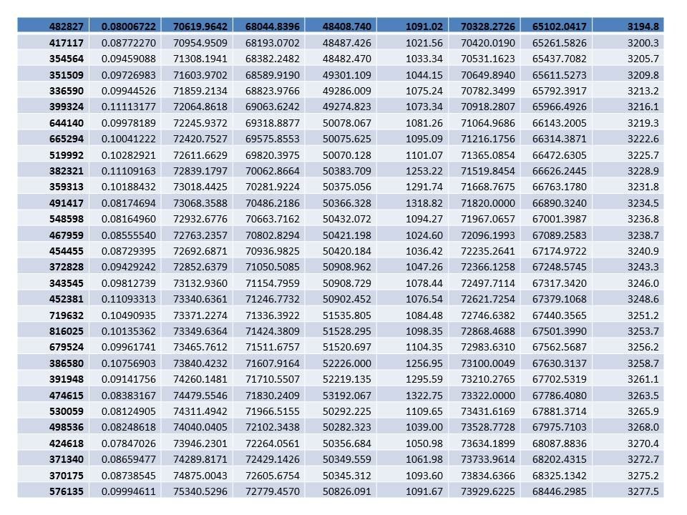
Module 1: Using Microsoft Excel Spreadsheets
Today’s Meaningless Data -- Review Carefully
Revised

Slide 13
What is a Spreadsheet?
A computer program that stores data in a tabular format.
A computer program with features and/or capabilities that include
Calculations of formulas
Production of charts and graphics
Data analysis tools capable of handling large quantities of data.

Slide 14
What is a Spreadsheet?
Spreadsheet packages are used to help the user understand and solve numerical problems
Used in almost every field of business, government, and academia.
Microsoft Excel is popular spreadsheet package
Others
VisiCalc – one of the original
Lotus 1-2-3 – first big package (still available)
Open Office – originally by Oracle
WordPerfect Office – Quattro Pro
Microsoft – Works (in 2009 out of production) became Microsoft – Office Starter Edition
Online Spreadsheet – Google Docs

Slide 15
Basics of Excel
Spreadsheet packages use worksheets of columns and rows to view the data.
A collection of worksheets make up a workbook.
Old default in MS Excel was 3 worksheets
A spreadsheet program, such as Excel, is used to create workbook files that contain one or more worksheets which contains tabular data.

Slide 16
Excel as a Statistical Tool
Useful functions in spreadsheet package
Enter data that is related
Develop relationship using math & statistical tools
Look at results when changes occur
Present data in “more easily” understandable manner
Charts
Tables
Graphs
Help in decision making

Slide 17
Excel Basics
Entering Data in Excel discussed in this class.
Fill – series data
Create formula
Copy – Icons vs. cross hair vs. Key strokes
Locking on “Key Cell” with F4 function key
Use of $ in formula
Naming an array for repeated future use
Creating formulas and solve problems
Sum function vs. keying in plus symbol
Product function vs. keying in multiplication symbols
Power function vs. keying in ^ for exponential
Count function vs. counting cells and values
Edit data that is in a worksheet
Go to Worksheet – Basic Excel

Slide 18
Module 2: Describing Data: Graphical Presentations
Making the Complex look Simple – Understood at glance

Slide 19
Good Graphical Presentations
Graphics can aid a presentation’s understandability
Use Excel to create common graphic presentations
pie chart,
bar charts,
simple histograms,
line charts, and
scatter plots.
Edit and modify charts

Slide 20
Bar Chart vs. Pie Chart
BAR CHART - A graph in which the classes are reported on the horizontal axis and the class frequencies on the vertical axis. The class frequencies are proportional to the heights of the bars.
Microsoft Excel calls this a “Column Chart”
PIE CHART - A chart that shows the proportion, percent or relative frequency that each class represents of the total number of frequencies.

Slide 21
Graphics made easy with Excel
Seniority of Employees | Frequency | Relative Frequency
0-5 years | 16 | 19.3%
6-10 | 19 | 22.9%
11-15 | 29 | 34.9%
16-20 | 8 | 9.6%
21-25 | 6 | 7.2%
Over 25 | 5 | 6.0%
Total Employees | 83

Slide 22
Other Graphics
Histogram
Histogram vs. Bar Charts
Line Charts – Good for showing changes in data over time.
Scatter Plots - similar to line graphs
Both vertical & horizontal access to plot data points.
Show if one variable is related to another – called correlation .

Slide 23
Line Charts
Precipitation by Year for 3 State Capitals
Year | Des Moines | Okla. City | Baton Rouge
2011 | 36.88 | 30.37 | 54.10
2012 | 27.07 | 29.49 | 78.95
2013 | 34.99 | 52.79 | 74.89
2014 | 42.27 | 28.38 | 65.64
2015 | 47.39 | 55.07 | 69.33
2016 | 36.84 | 26.32 | 87.78
2017 | 31.71 | 33.67 | 86.43
2018 | 45.89 | 45.83 | 93.12
2019 | 44.22 | 45.36 | 84.76
2020 | 31.65 | 38.57 | 81.31
Average | 37.89 | 38.59 | 77.63
Median | 36.86 | 36.12 | 80.13
Source: https://www.noaa.gov
See precipitation data

Slide 24
Line Charts and Bar Charts
Precipitation by Year for 3 State Capitals
Year | Des Moines | Okla. City | Baton Rouge
2011 | 36.88 | 30.37 | 54.10
2012 | 27.07 | 29.49 | 78.95
2013 | 34.99 | 52.79 | 74.89
2014 | 42.27 | 28.38 | 65.64
2015 | 47.39 | 55.07 | 69.33
2016 | 36.84 | 26.32 | 87.78
2017 | 31.71 | 33.67 | 86.43
2018 | 45.89 | 45.83 | 93.12
2019 | 44.22 | 45.36 | 84.76
2020 | 31.65 | 38.57 | 81.31
Average | 37.89 | 38.59 | 77.63
Median | 36.86 | 36.12 | 80.13

Slide 25
Graphics Aid to Understanding
Seniority of Employees | Mid Point | Average Income
0-5 years | 2.5 | 42,195
6-10 | 7.5 | 52,315
11-15 | 12.5 | 67,685
16-20 | 17.5 | 77,819
21-25 | 22.5 | 108,939
Over 25 | 30 | 76,724
Employee # | Seniority of Employee (years) | Income
1001 | 1 | 39,940
1002 | 5 | 67,949
1003 | 7 | 53,696
1004 | 15 | 38,003
1005 | 21 | 43,586
1006 | 23 | 190,876
1007 | 4 | 40,434
1008 | 4 | 78,514
1009 | 2 | 37,620
1010 | 3 | 34,217
1011 | 15 | 94,216
1012 | 11 | 90,094
1013 | 24 | 58,048
1014 | 21 | 67,194
1015 | 16 | 52,377
1016 | 14 | 133,509
1017 | 4 | 35,310
1018 | 17 | 38,711
1019 | 20 | 60,697
1020 | 15 | 101,961
1021 | 23 | 79,014
Go to Worksheet - Graphics

Slide 26
Review of 1& 2
Let’s go back quickly plus add some points
Worksheet - review

Slide 27
Module 3: Describing Data – Measures of Central Tendency
Pictures are worth a 1,000 words – Numbers give the true details

Slide 28
Meaning of Central Tendency
Explain the characteristics and uses of measures of central tendency
Explain the characteristics and uses of measures of dispersion
Use Excel functions to calculate the arithmetic mean, median, mode, and standard deviations
Use Excel’s Analysis ToolPak add-in to find measures of central tendency and dispersion

Slide 29
Meaning of Central Tendency
A single value that attempts to describe a set of data by identifying the central position within that set of data.
A measure of location
Sometimes referred to as point estimate
Most common is Average (Mean)
Others are Median and the Mode.

Slide 30
Dispersion around
Measures of Dispersion help to know the spread around the central tendency.
Range – give difference between high & low
Standard Deviation – how clustered are the values around the central tendency.
Indication of likelihood of values relatively near central tendency or relatively far away.
Knowing mean is wonderful, knowing dispersion gives understanding.

Slide 31
Statistical Function in Excel
Average (mean) =AVERAGE(numbers)
Median =MEDIAN(numbers)
Mode =MODE(numbers)
Standard Deviation (to include population vs. sample)
2007 and before | 2010 and after
=STDEV(numbers) | = STDEV.S(numbers)
=STDEVP(numbers) | =STDEV.P(numbers)

Slide 32
Data Toolpak
Using the Descriptive Statistic
Column1
Mean | 43670.14012
Standard Error | 4006.646402
Median | 29834.87583
Mode | #N/A
Standard Deviation | 36502.28592
Sample Variance | 1332416877
Kurtosis | 6.66484503
Skewness | 2.623861794
Range | 164780.6589
Minimum | 18906.44908
Maximum | 183687.108
Sum | 3624621.63
Count | 83
Go to Worksheet – Central Tendency

Slide 33
Module 4: Confidence Interval
Sweat the small stuff – You have done all the work, but is it right.

Slide 34
What’s a Confidence Interval?
Suppose you conduct a study and arrive at some statistics from your study, e.g. :
Sample Mean
Sample Standard Deviation
Sample Range
How certain are you that your sample statistics represents the Population’s parameters?
Need to introduce some terminology.

Slide 35
Terminology – Point Estimate
Point estimate is a single value sample statistic used to estimate a population parameter.
Χ | for | µ
Sample Mean | for | Population Mean
S | for | σ
Sample Standard Deviation | for | Population Standard Deviation

Slide 36
Terminology – Confidence Interval
Confidence Interval is a technique used to indicate the reliability of an sample’s statistic as a estimator of the population parameter.
Samples do not replicate the population perfectly.
A Confidence interval is a range of values (interval) that likely contain the population parameter.
Confidence Interval = point estimate ± sample error

Slide 37
Determinants of Confidence Interval
What determines the width of a confidence interval?
1. The sample size, n.
2. The dispersion in the population, usually σ estimated by s.
3. The desired level of confidence.
Potential µ
X

Slide 38
How to Calculate
s
C.I. = X t
∓
√
n
C.I. = Confidence Interval
X = sample mean
t = t statistic
s = sample standard deviation
n = sample size
Go to Worksheet – Confidence Interval

Slide 39
Review of 3 & 4
s
C.I. = X t
∓
√
n
Let’s go back quickly. Touch up some points
Worksheet - review

Slide 40
Module 5: Linear Regression
Are these two variables related? -- How much?

Slide 41
Linear Regression
Purpose is to develop a better understanding the relationship between two variable being studied.
Independent variable
Dependent variable
Goal in Linear Regression:
Develop an equation to express the relationship b/t variables.
Use the equation to estimate the value of the dependent variable using the independent variable as a predictor.

Slide 42
Terminology
The dependent variable (criterion) is the variable being predicted or estimated.
The independent variable (predictor) provides the basis for estimation.
Examples :
Smoking cigarettes increases the likelihood of a person getting lung cancer.
Lung cancer is the dependent variable.
Smoking is the independent variable
Larger house have a higher selling price
Selling price is the dependent variable
Square footage is the independent variable

Slide 43
Start with Scatter Diagram Remember back in Module 2
Square Footage | House Prices
3,840 | 300,000
1,510 | 71,500
435 | 36,000
3,150 | 114,500
1,626 | 135,000
1,014 | 32,000
1,529 | 110,000
1,056 | 75,000
1,201 | 108,500
1,892 | 370,000
2,070 | 506,666
2,041 | 380,000
1,959 | 340,000
1,199 | 230,000
1,254 | 100,000
9,24 | 22,000
Does there appear to be a relationship?

Slide 44
What is a Correlation
Correlation is numerical measures used to express the strength of the relationship between two variables.
Many examples of a relationship of correlations:
MPG and the car’s weight.
Quantity of fuel burned and CO₂ emissions
Number of red squirrels in Ohio and Stock Market Prices
And from previous slide, the square footage of a house and selling price.
Does correlation mean causation?

Slide 45
Coefficient of Correlation
The coefficient of correlation (r) is a measure of the strength of the relationship between two variables.
Shows the direction and strength of the linear relationship between two interval or ratio-scale variables.
Correlations ranges from –1.00 to +1.00
Values of –1.00 or +1.00 indicate perfect or strong
Values close to 0.0 indicate weak correlation.
Negative values indicate an inverse relationship
Positive values indicate a direct relationship.
See precipitation data

Slide 46
Next build Regression model
The independent variable (X) is used to estimate the dependent variable (Y).
A Regression Equation is an equation that expresses the linear relationship between two variables.
A math process called least squares technique is used to determine the equation.
Minimizes the sum of the squares of the vertical distances between the actual Y values and the predicted values of Y, called Y hat.
^
= a + b X
Y

Slide 47
Least Squares approach
A
Modeled Regression Line
B

Slide 48
What determines good Regression Line?
Rules to follow:
Logical relationship – relationship between X and Y variables is logical.
Correlation Coefficient (r) is good
Coefficient of Determination (r²) is good
b slope of the line (coefficient of X) is correct
t value > 2.2 (rule of thumb)
Standard error is low
Go to Worksheet – Regression Model

Slide 49
Module 6: Lognormal
Congratulations Jimmi Lynn
-- First Prize

Slide 50
What is Lognormal?
Lognormal – a distribution of a random variable for which the logarithm of the variable has a normal distribution.
Positively skewed distributions are particularly common when:
Mean values are low,
Variances large
Values are not zero, and
Values cannot be negative

Slide 51
What is Lognormal?
Log-normal – a distribution of a random variable for which the logarithm of the variable has a normal distribution.

Slide 52
Examples of Lognormal Distributions
Skewed distributions often closely fit the log-normal distribution - examples:
Lengths of latent periods of infectious diseases,
Distribution of mineral resources in the Earth’s crust
Inheritance of fruit and flower size
Return on equities in stock market
Survival rates of cancer patients
Failure rates in product tests.
Rainfall in Las Vegas

Slide 53
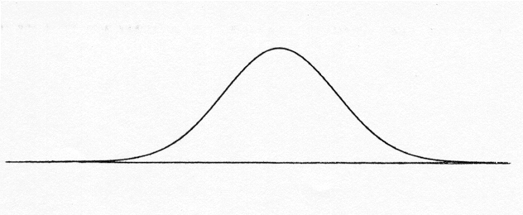
Normal Distribution
Before Excel:
1st Solve for Z
Z=(X-µ)/σ
2nd Use a Z table to find
the probability
The Excel function is =NORM.DIST(X,µ,σ,Cumulative) Where Norm Function gives probability of area < X:
X = observation
µ = Mean
σ = Standard Deviation
Cumulative is either true or false
µ
X
=NORM.S.DIST((LN(X) - Mu)/Sigma,Cumulative)
Z=(LN(X)-µ)/σ

Slide 54
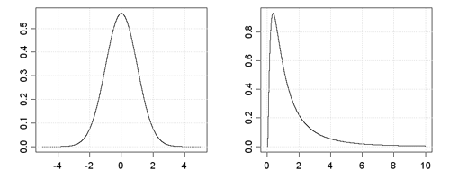
Lognormal Distribution
But we’re using function where LN(X) is normal
Suppose you get monthly data for Rainfall in Las Vegas.
You see it has the characteristics of Lognormal
Mean is low and Variance is fairly large
Normal
Lognormal
0.036
0 1 2 3 4 5
µ = 0.3519
σ = 0.572
P(X) > 4
Go to Worksheet – Lognormal Worksheet

Slide 55
Review of 4-6
Let’s go back again
Worksheet – review 3

Slide 56
Excel Statistics
240 CenSARA
Instructor: Steve Hiebsch
Email: steve.hiebsch@gmail.com
Open file named, “7 Post-Test Excel …” and complete it
Post-Test 240CenSARA

